Slide 1
ConfeyCAN
Data Collection and Data Analysis
A Presentation for the CanSat European finals, 2016

Slide 2
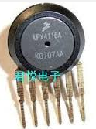
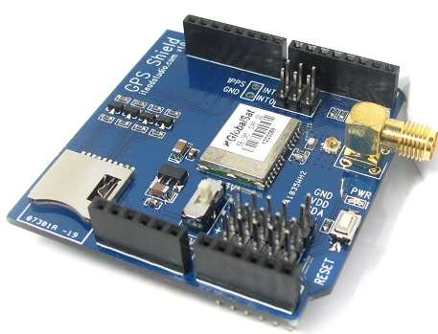
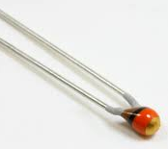
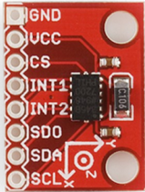
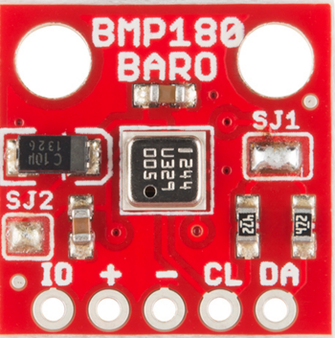
Coding for secondary missions…
Uses 1 A pin
Uses 1 A pin
Uses 1 A pin
Uses 1 A pin
2 A pins remaining
Not enough Analog inputs
No room/time for a multiplexer
Solution: I²C protocol allows sharing of inputs
3 sensors suitable to use I²C
Programs pasted from internet
I²C sensors

Slide 3
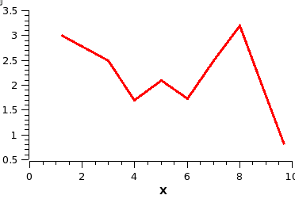
Getting the Data cleaned up…….
ARDUINO
program output
Secondary Data.xls
canLOG.txt
Cleandata. txt
PYTHON
program

Slide 4
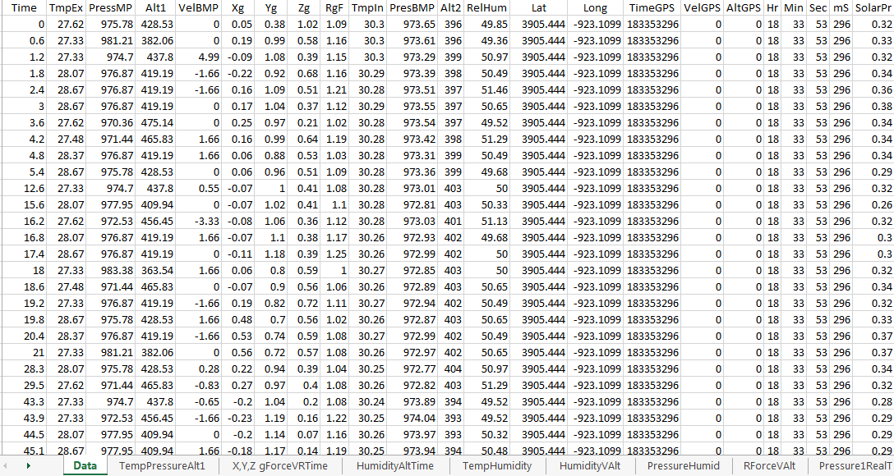
Our data
Time (s)
Data
lost on Three occasions
Only some of the pre-prepared graphs
More Graphs

Slide 5
Drop
Pressure, Temp Vs Real Time for MPX4115

Slide 8
Team ConfeyCAN thanks you for this great experience.

