Slide 1
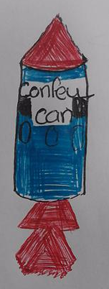
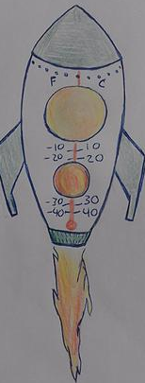
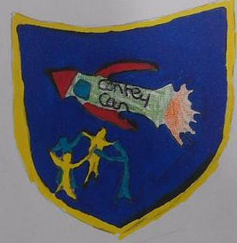
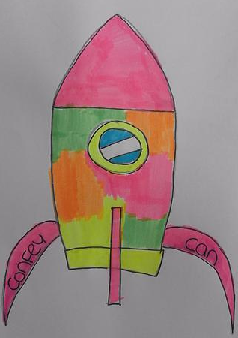
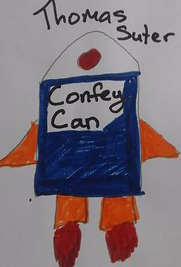
Confey CAN!
By Confey College

Slide 2
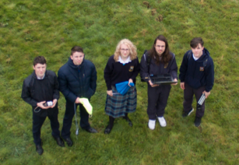
Project Overview
The TEAM
CanSat Construction
Programming and Coding
Testing and Calibration
Parachute Construction
Community Outreach
Data Analysis

Slide 3
The Team and the wider team:
Liam – Outreach/Communication (TL)
Conor – Calibration/Construction
Gergely – Software/Data presentation
Julia – Parachute Analysis/Design/Construction
Alex – Data analysis/Presentation
Naoise, Denis, Kieran, William…

Slide 4
Primary and Secondary Mission
Satellite location via GPS and LED’s
Look at Pressure Vs Altitude
Temperature Vs Altitude
Humidity Vs Altitude
gForces experienced during flight
Vertical Velocity over time
Link video of flight with graphs

Slide 5
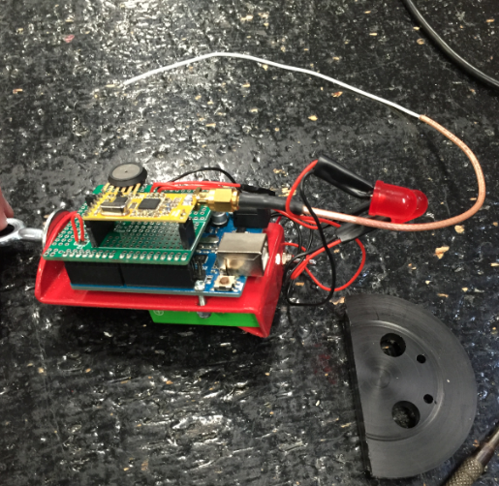
Original Cansat Construction
- Plastic coated metal frame
in a
polycarbonate casing
On/off switch

Slide 6
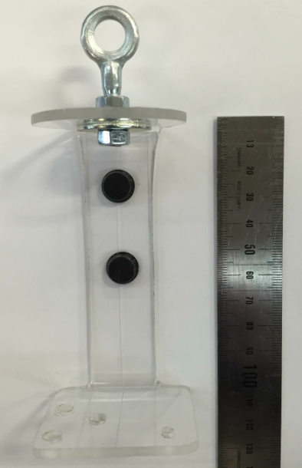
Secondary Mission – Signal LOSS:
Plastic coated Metal
→ changed to
Smaller PolyCarb spine

Slide 7
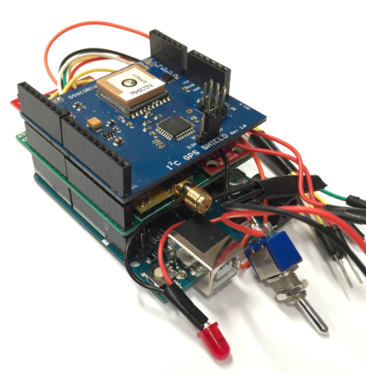
Secondary Mission GPS Signal LOSS:
modified shield headers so GPS shield sits on top

Slide 8
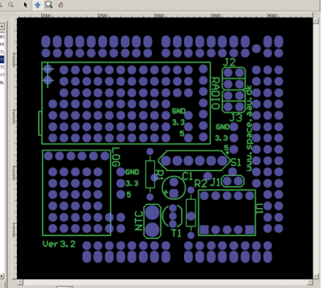
Fitting the sensors into PCB:
accelerometer
BMP180Pressure
Relative Humidity

Slide 9
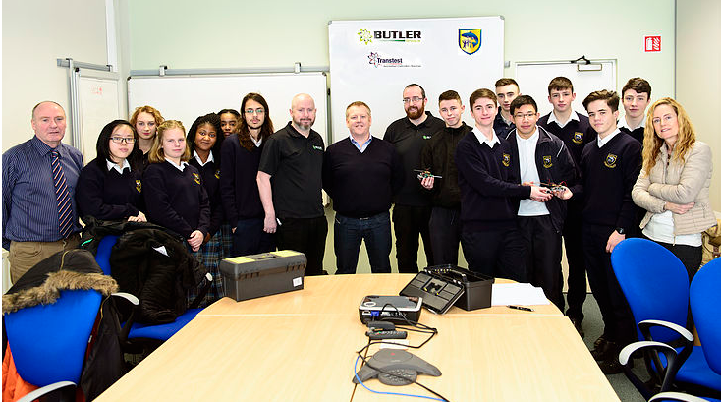
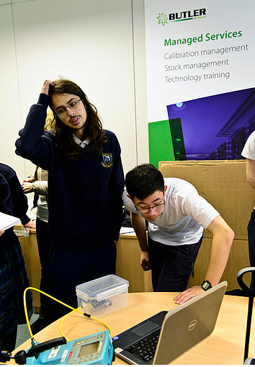
Testing and Calibration
Butler Transtest Calibrations(EU)CE:
-Thermistor
(industrial temperature regulator)
-Pressure Sensor (sealed lunch box and
pressure pump )

Slide 10
Thermistor Calibration Data
Formula used in Arduino
program
* Different thermistor to kit

Slide 11
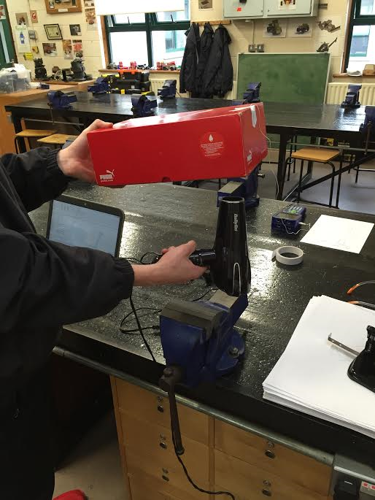
Further Calibration:
BMP180 Barometric Pressure/Temp sensor
Pressure: against MPX4115A
Temperature
– Hairdryer/Freezer

Slide 12
BMP180 Calibration:

Slide 13
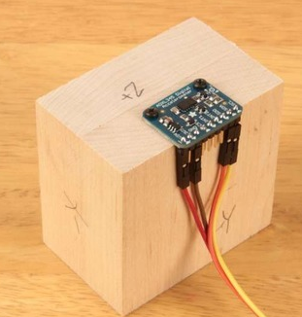
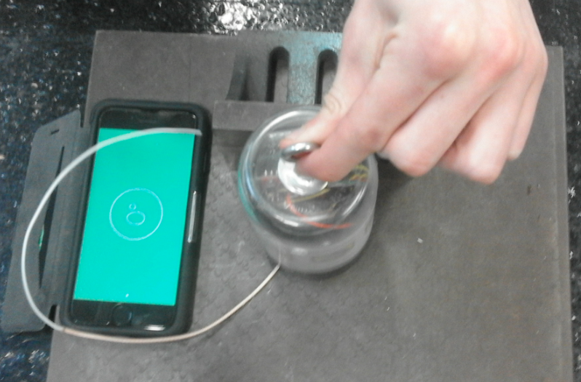
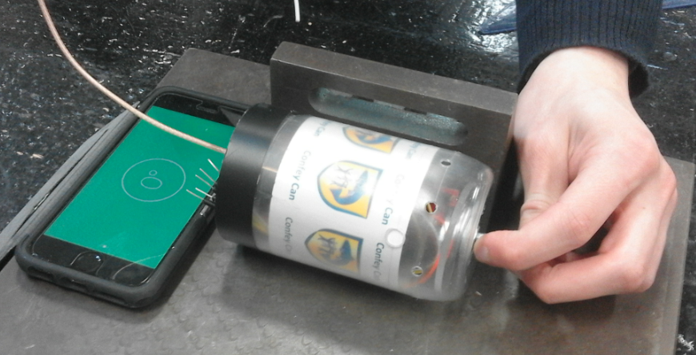
Further Calibration:
ADXL345 Accelerometer
* Tested All 3 axis in both directions - offset

Slide 14
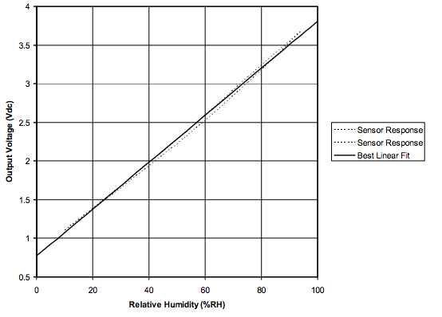
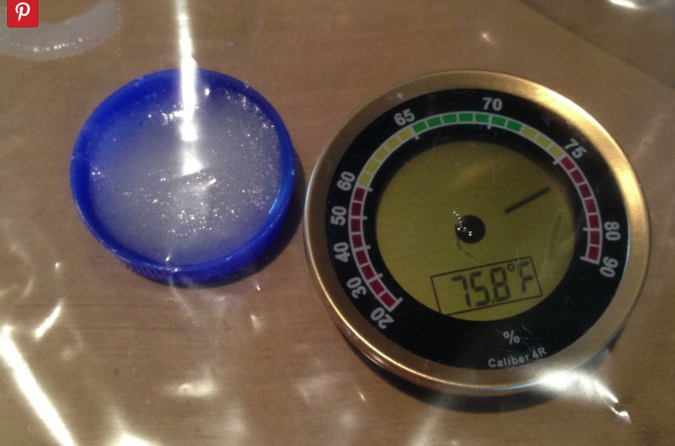
Further Calibration:
HIH4030 Relative Humidity sensor

Slide 15
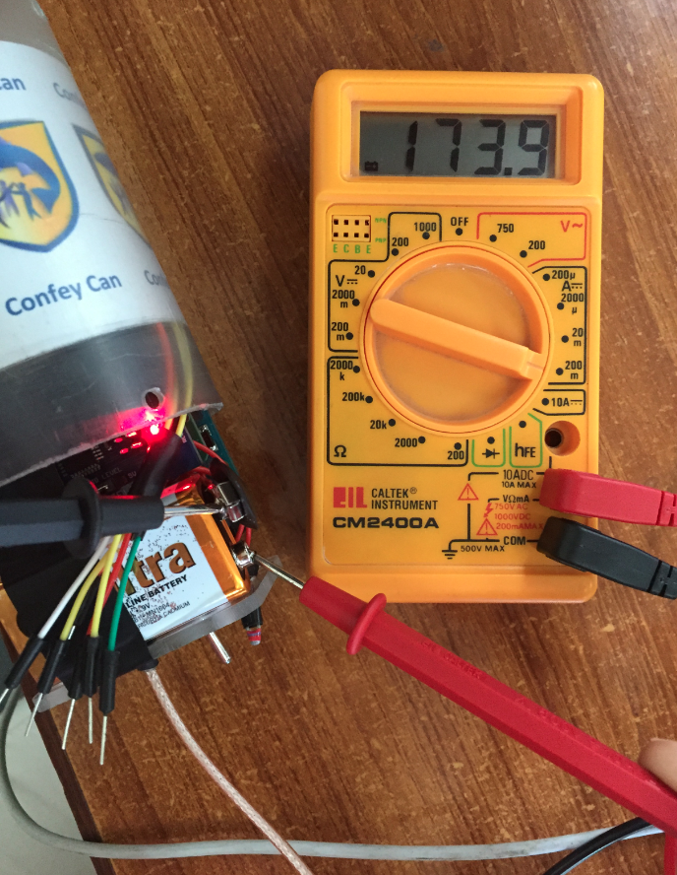
Power Consumption:
173.9 mA when running
9v Battery capacity 600mAh
650/173.9 = 3.73 hrs
BUT larger current lower capacity so unsure..
use 6 x 1.5V AA in series
Voltage regulator inefficient

Slide 16
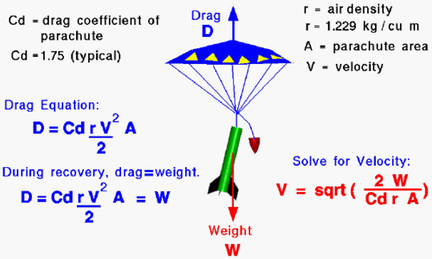
The Parachute – Terminal velocity
Cansat breaks
11 m/s ≥Terminal velocity ≥ 8m/s
Cansat drifts
What affects Terminal velocity:
Area of material
Drag Coefficient
Shape of parachute
Cross, Hemispherical
Polygon, Parapent
Weight (mg) of can
-Density of Air

Slide 17
The Parachute – Stabiliity (need can to stay upright)
What affects Stability :
Strong fibres when ejecting (nylon)
- Strong fabric (ripstop)
- Hole(s) ??
- Mini central parachute

Slide 18
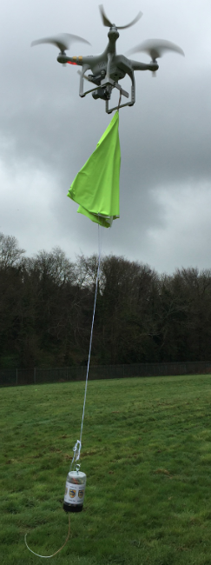
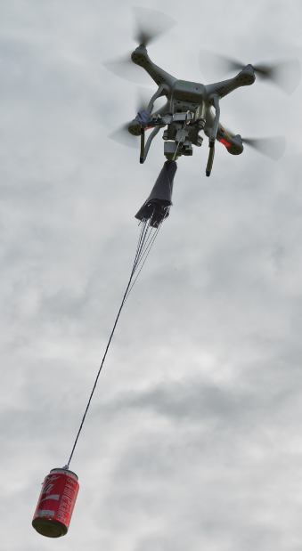
Parachute testing
4 Prototypes
- Cross, Hemispherical, 2 Octagons
Drone testing x 2
Lost one!
2 choices (weather)

Slide 19
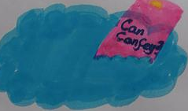
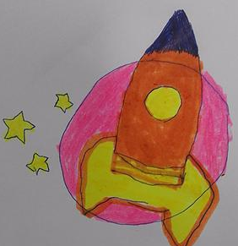
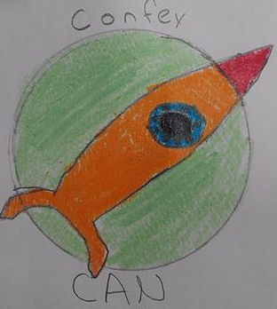
Outreach
Public Communications
- Butler tech –very willing to work with Confey students again!
- Contacted Dunnes Stores for sponsorship/prizes
Spoke with representatives from Intel/HP/Salesforce 2 Apple Macs were donated to CONFEYCAN
Have written article for two local newspapers
Local photographer used Quadcoptor

Slide 20
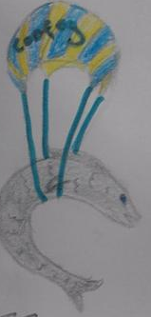
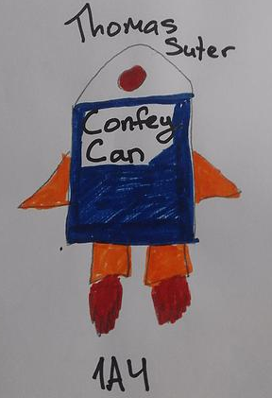
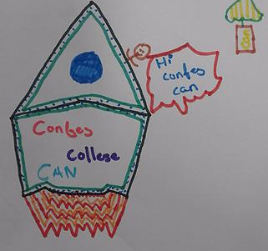
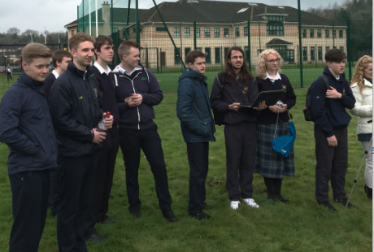
Outreach
In our school ..
- Survey/Online Design Competition
-Team name
-Team logo
- 100’s of entries
Open day presentation
800 attendees
5th Years attend launch

Slide 21
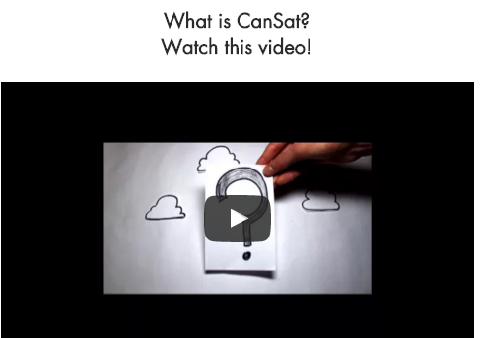
Outreach
Website Construction
- Home Page
- Infomercial (ESERO)
- Survey competition
- Blog
- Photos/Videos

Slide 22
Programming and Coding
Transmitting Data
-Rf Magic/Terminal
- Baud rates/loop delay
The wire Antenna
- our working frequency (444MHz)
- Length = c/4f = 3x10⁸ = 0.169m
4 x 444 x 10⁶

Slide 23
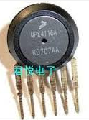
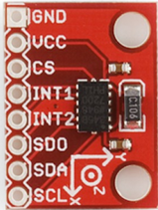
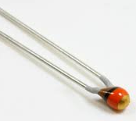
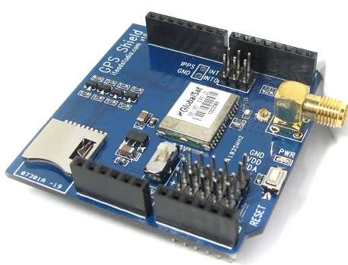
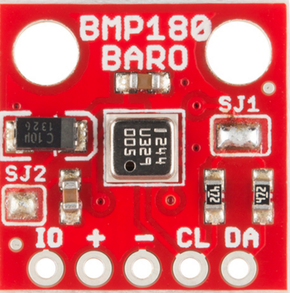
Coding for secondary missions…
1 A pin
1 A pin
1 A pin
3 A pins
2 A pins
Not enough Analog i/ps
No room/time for a multiplexer
I²C protocol – share inputs
2 sensors could work with I²C
Added extra Pressure sensor (I²C)

Slide 24
Coding continued….
SPI and I²C protocol
Found programs online (changed baudrate)
Copied and pasted..WORKED!
Edited to give the outputs we wanted

Slide 25
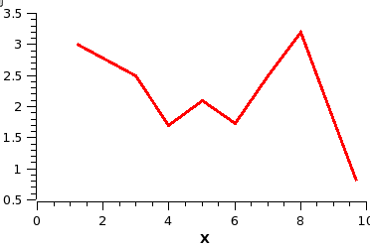
Getting the Data cleaned up…….
ARDUINO
program output
Cleandata. txt
ConfeyCanData.xls
canLOG.txt
PYTHON
program

Slide 26
Data Analysis:

Slide 27
Data Analysis:

Slide 28
Data Analysis:

Slide 29
Data Analysis:

Slide 30
Data Analysis:

Slide 31
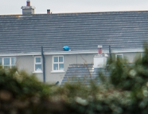
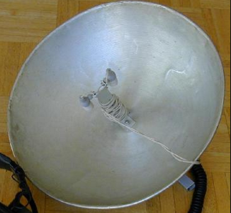
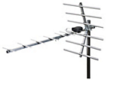
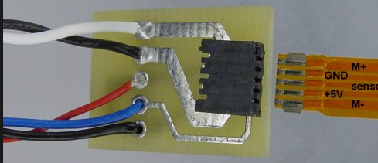
Improvements for EUROPE:
Increase parachute terminal velocity
Improve signal reception
More Flexible Wiring
Tidy code

Slide 32
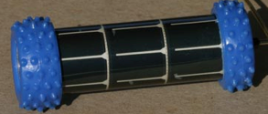
The BIG picture:
CanBot !

Slide 33
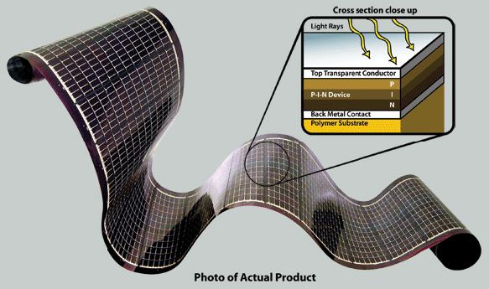
Additions for Europe:
Flexible Solar
Panels:
To recharge
CanSat during/after landing
As a means of detecting Solar Radiation strength

Slide 34
Additions for EUROPE:
2 Way
Communication:
CanSat to relay messages from planet/groundstation
Ground station to ‘talk’ to CanSat
(go to sleep)

