Slide 1
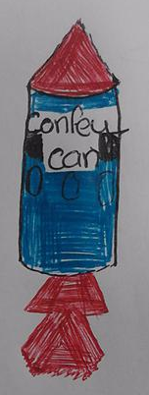
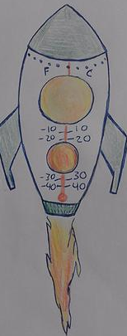
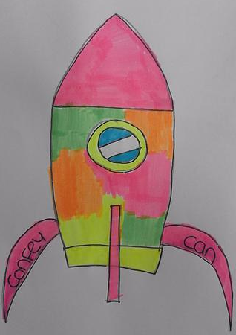
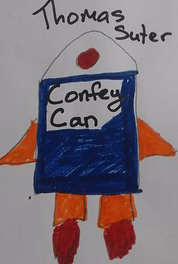
Confey CAN!
By Confey College

Slide 2
Project Overview
The TEAM
CanSat Construction
Programming and Coding
Testing and Calibration
Parachute Construction
Community Outreach
Data Analysis

Slide 3
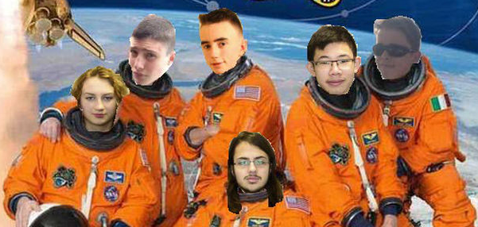
The Confey team

Slide 4
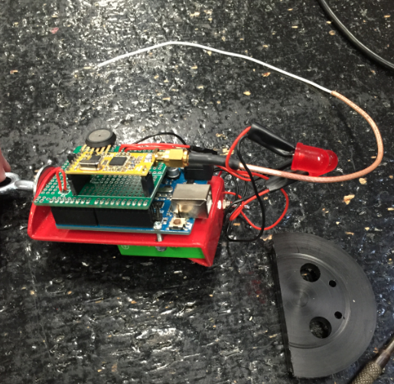
Cansat Construction
Material selection/processes
- CanSat casing
- wire antenna
- Large LED’s
- Soft soldering
- Plastic coating
Primary & Secondary Mission
- First time in Cansat – concentrated on
getting Primary mission completed
- Pressure sensor and thermistor
- program to calculate Altitude and velocity
On/off switch

Slide 5
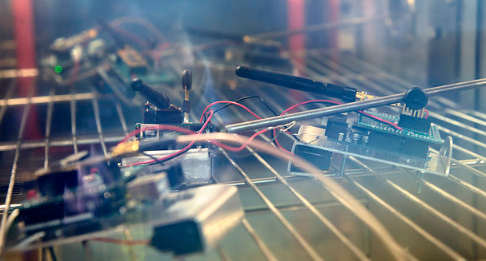
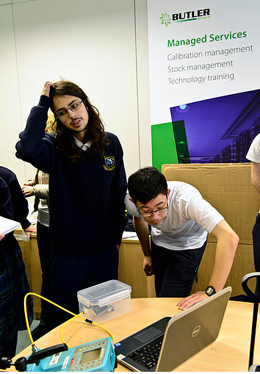
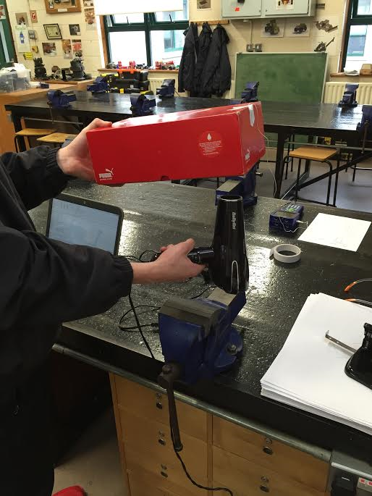
Testing and Calibration
Butler Transtest Calibrations
-Thermistor (industrial temperature regulator)
-Pressure Sensor (sealed lunch box and pressure
pump)
Self-Calibrations
- Changed thermistor
- Hairdryer & shoebox
-Freezer

Slide 6
Thermistor Calibration Data
Formula used in Arduino
program
* Different thermistor to kit

Slide 7
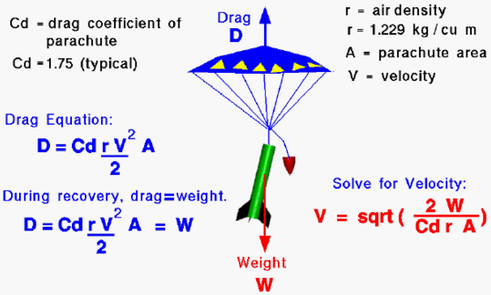
The Parachute – Terminal velocity
Cansat breaks
11 m/s ≥Terminal velocity ≥ 8m/s
Cansat drifts
What affects Terminal velocity:
Area of material
Drag Coefficient
Shape of parachute
Cross, Hemispherical
Polygon, Parapent
Weight (mg) of can
-Density of Air

Slide 8
The Parachute – Stabiliity (need can to stay upright)
What affects Stability :
Strong fibres when ejecting (nylon)
- Strong fabric (ripstop)
- Hole(s) ??
- Mini central parachute

Slide 9
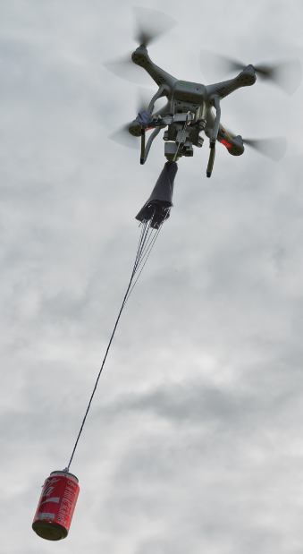
Parachute testing
4 Prototypes
- Cross, Hemispherical, 2 Octagons
Drone testing
Lost our best one!
Using our 2nd best!

Slide 10
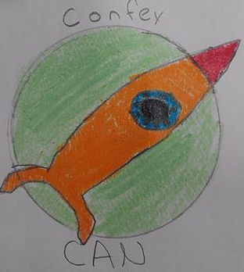
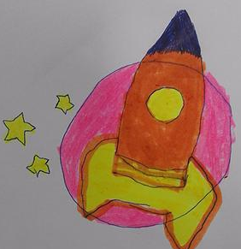
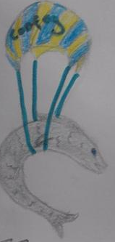
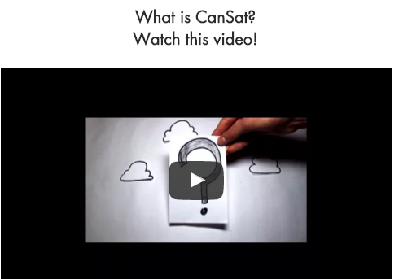
Outreach
Public Communications
- Butler tech –very willing to work with Confey students again!
- Did a presentation to parents/students at school open night
- Contacted Dunnes Stores for sponsorship/prizes
Survey/Online Design Competition
-Team name
-Team logo
- 100’s of entries
Website Construction
- Home Page
- Infomercial
- Survey competition
-Blog
- Photos/Videos

Slide 11
Programming and Coding
The Program
- Converting Voltage into Temperature data
- Converting Pressure into Altitude
- Calculating Velocity using Altitude
- Calculating time in secs
Transmitting Data
-Rf Magic/Terminal
- Baud rates/loop delay
The wire Antenna
- our working frequency (444MHz)
- Length = c/4f = 3x10⁸ = 0.169m
4 x 444 x 10⁶

Slide 12
Getting Data into Excel/Powerpoint
Terminal output -→ log file x
Excel file linked to log file and data is updated on refresh
Data plots set up in separate sheets in Excel
Powerpoint slides linked to these charts and data can be refreshed

Slide 13
Data Analysis:

Slide 15
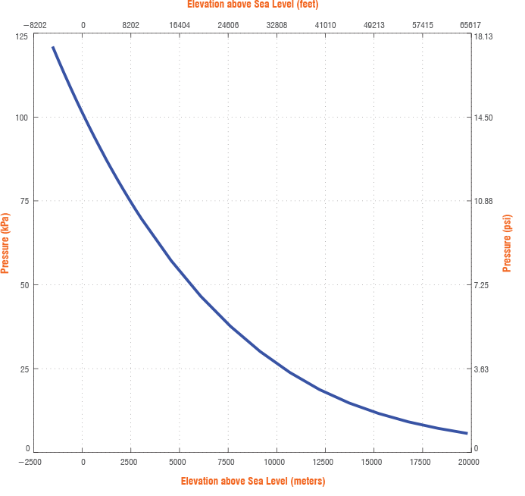

Slide 16
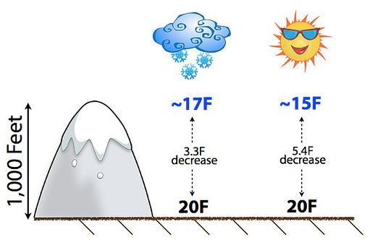
If the humidity is at 100% (because it’s snowing!), the temperature decreases more slowly with height.

Slide 17
If the humidity is at 100% (because it’s snowing!), the temperature decreases more slowly with height.

Slide 18
IMPROVEMENTS we would make:
Work on secondary missions (accelerometer, location tracking, guided landing)
Try to get data real time into charts and have a program automatically editing it first to remove anomolies/text data
Work on power consumption/battery lifetime (not so critical when we only have primary mission)
Look for more sponsorship – talk to more local businesses

Slide 19
We have learnt the importance of:
Planning in advance
– breaking a project into smaller tasks and allocating responsibilities early on – helps to focus team
Communication
- must meet regularly to ensure work is carried out in time
Timing – allow for things to go wrong
- because they DO! (see next slide)

Slide 20
And .. the Importance of …
Being prepared – for things going wrong at last minute:
Parachute in tree (had spare prototype)
Butlertech – we needed equipment to resolder thermistor on spot
Quadcopter in field – needed equipment in field to fix on bracket when it fell off

