Slide 1
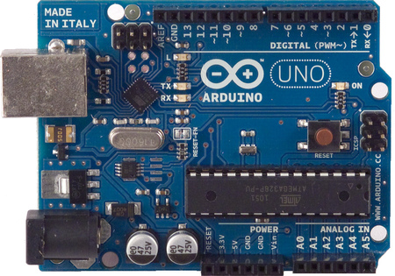
Introduction to Arduino Microcontrollers
Notes:
*

Slide 2
What is a Microcontroller ? What is a Microprocessor ?
A Microcontroller (8 bit) does one task very fast and very well, like a cell phone, microwave, house alarm, etc. It's does one program over and over again and never changes, programed stored in ROM and has all I/O support hardware onboard the chip. Can be very low power i.e. Thermostat - Nano Watts!
A microprocessor (32/64 Bit) on the other hand can run multiple programs and change programs, just like your PC. Does very large complex programs and very complex math and has external I/O support like video cards, audio, lan, etc. and storage on large disk. Is a power hog! 500Watts!
The line is blurring between these two. For example ARM processors (32 Bit) for example used in a smart phone. These microcontrollers are so powerful they run multiple programs very similar to microprocessor but keep the low power characteristic of a microcontroller

Slide 3
What is Arduino?
Physical computing platform
Open source
“Hardware Abstracted” Wiring Language-similar to ‘C’
USB programmable
Large community
Multi platform Win/Mac/Linux
Inexpensive
€20 Radionics

Slide 4
What is Arduino?
Based on ATmega328 – 8 BIT
w. USB interface
Voltage regulator (5V)
Specs
RISC @ 16 MHz, 20 MIPS
32 K Memory (.5K bootloader)
6 Ch. 10 Bit A/D
6 Ch. PWM, I2C, SPI
The “popularity” is in:
- Standard board design
- Wiring language
- Open Source

Slide 5
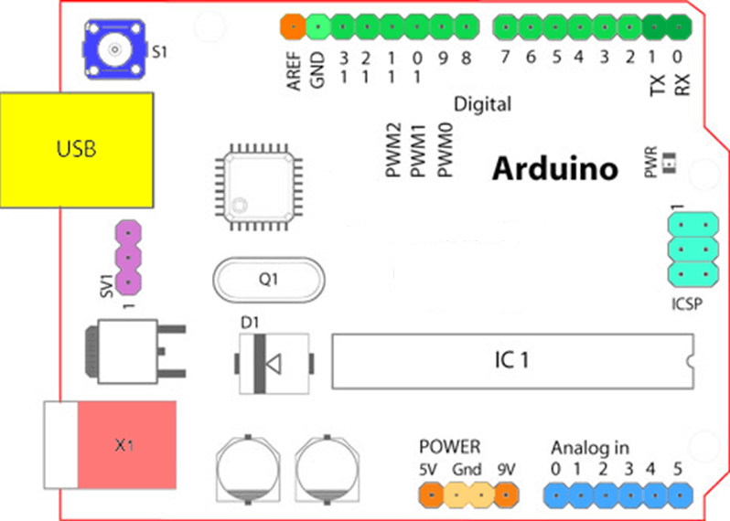
Arduino Board Overview

Slide 6
What do these do?
Digital IO (LEDs, switches)
Analog IO (resistive sensor data)
Serial Connection (Sensors, GPS, etc.)
Program from your computer
Your limit is only your creativity!
Notes:
*
The digital inputs and outputs can sample a digital high or low signal and can sample voltage. These can be used with resistance-based sensors, such as thermistors, force sensors, light sensors, etc.
Analog inputs can input or output a stream of data. This is useful for things like GPS, data logging.

Slide 7
Terminology
I/O Board - main microcontroller
Shield - add-on boards
Sketch - the program
Sensor - components (thermistors, etc.)
Modules - serial data (GPS module, etc.)
Notes:
*
The primary terms you need to know are what the I/O Board is, what a shield is, and what a sketch is.
The I/O Board is the "brains" of the operation. You program these from your computer.
A Shield is a device that plugs into an I/O Board. These extend the capabilities of the I/O Board.
A Sketch is a program written for the board and shields.

Slide 8
Arduino I/O Boards
14 current boards
Notes:
*
These are some of the various Arduino I/O boards. Clockwise from the top left is an Uno (great starter board), a Lilypad (normally used for clothing applications), a Pro (very small), a Mega (very powerful), and an Ethernet Board.
These boards all have analog and digital input/output. The Uno and Mega have the USB programming interface included - the other boards need an additional board to plug in (or solder in) to program.
There are more boards than just these!
The prices for these run as low as $20, as high as $60. The Uno is $30, which is generally the best place to start.

Slide 9
Shields
Notes:
*
Shields connect to the I/O board to extend it's functionality. Hundreds of shields are available, and you can make your own.
Starting from the upper left going clockwise:
Bluetooth Shield
Color LCD Shield
GPS Shield
Power Driver Shield (connects to a computer power supply).
Shields can run as low as $15, as high as $200.
Bluetooth $40-$65
LCD: $40
GPS: $80
Power Driver: $20

Slide 10
Shields

Slide 11
Shields
Datalogging Shield
Wave Shield
Touchscreen Shield
Notes:
*
The shield on the left is a touchscreen shield, the upper right is a light and temperature shield, and the lower right is a sound (music) shield.

Slide 12
More Shields…
XBee Shield
Ethernet Shield
WiFi Shield
Notes:
*
Communication shields - XBee, Ethernet, and WiFi (2.5 Ghz).
These run around $60-$80.

Slide 13
Sensors
Fingerprint Scanner
Gas Sensor
Temp & Humidity
Flex Sensor
Geiger Counter
Notes:
*
Shields aren't the only way to extend an Arduino board - you can hook sensors to it! These are some of the hundreds (if not thousands) available. Many of these are not made specifically for Arduino - some sensors, such as thermistors, you can get from Radio Shack and wire them in!
Sensors can run as low as $0.95 (for a thermistor or light sensor) to $150 (Geiger counter sensor)

Slide 14
Sensors
Photo/thermistor, infrared, force sensitive resistor, Hall effect, Piezo, tilt sensor..
Notes:
*

Slide 15
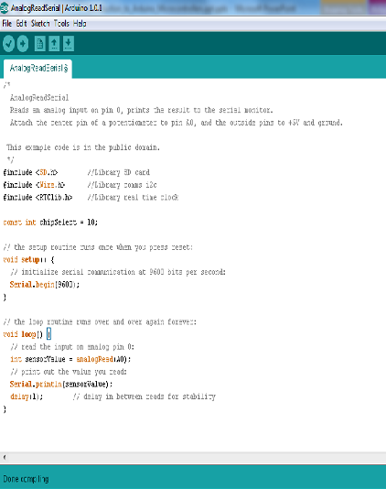
Sketches
Includes
Globals
void setup()
void loop()
Notes:
*
Sketches are built in the Arduino Development Kit. The dev kit is free and open source. It is basically a simplified C++ processor.
The sketch is then uploaded to the Arduino I/O board and will run.

Slide 16
Binary
A switch has 2 positions; ON or OFF
In binary, we call these ; 1 or 0
There are 2 states so
Instead of counting in 10’s (decimal) we count in 2’s.

Slide 17
Binary
Decimal: 5632 =
5x1000 + 6x100 + 3x10 + 2x1
5x10³ + 6x10² + 3x10¹ + 2x10⁰
Binary: 101110 =
1x2⁵ + 0x2⁴ + 1x2³ + 1x2² + 1x2¹ + 0x2⁰
32 + 0 + 8 + 4 + 2 + 0

Slide 18
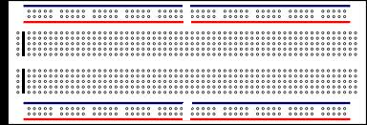
Breadboard

Slide 20
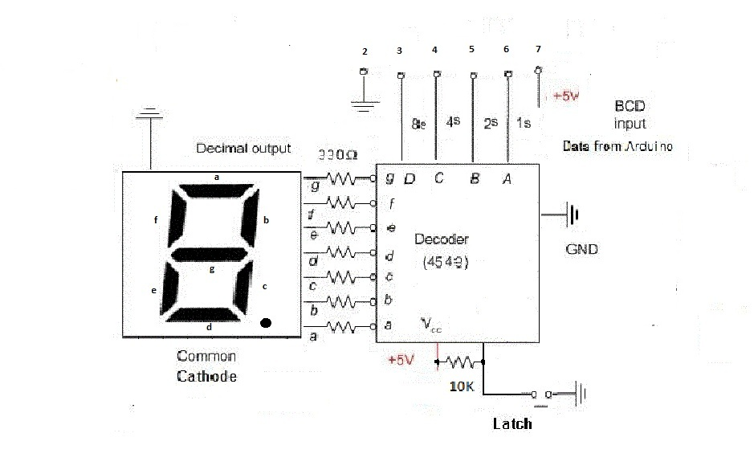

Slide 21
Convert decimal (X) to binary. X/8 or X/2³ ^{Ans = 1 hence D = HIGH} ^{Ans = 0 hence D = LOW} X%8 = decimal for 3 LSB's remaining ^{Repeat above}
X D C B A
0 0 0 0 0
1 0 0 0 1
2 0 0 1 0
3 0 0 1 1
4 0 1 0 0
5 0 1 0 1
6 0 1 1 0
7 0 1 1 1
8 1 0 0 0
9 1 0 0 1

