Slide 1
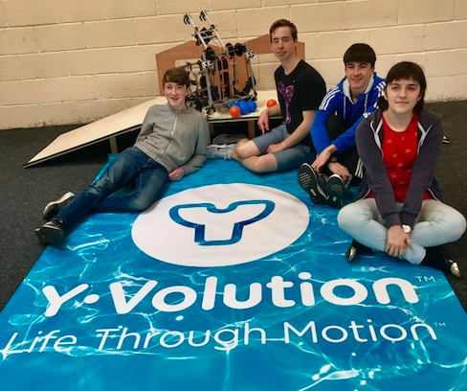
FIRST GLOBAL World Robotics Competition
Team IRELAND

Slide 2
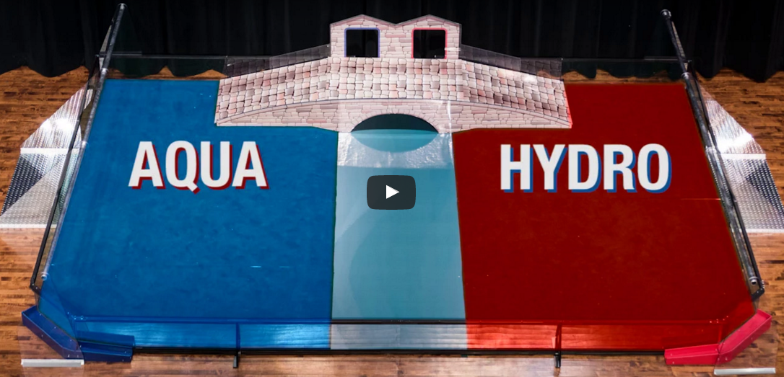
The FIRST CHALLENGE 2017 !

Slide 3
Our PRESENTATION:
BACKGROUND INFO
ROBOT DESIGN and MODIFICATIONS
OUTREACH
WHAT WE HAVE LEARNT
DEMO

Slide 4
Confey Community College

Slide 5
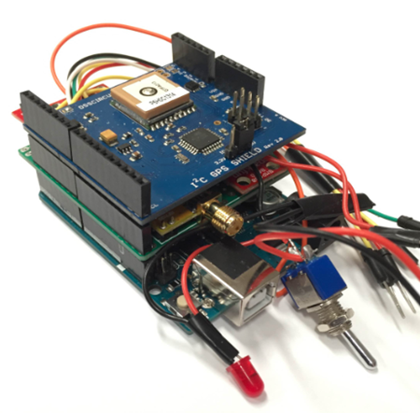
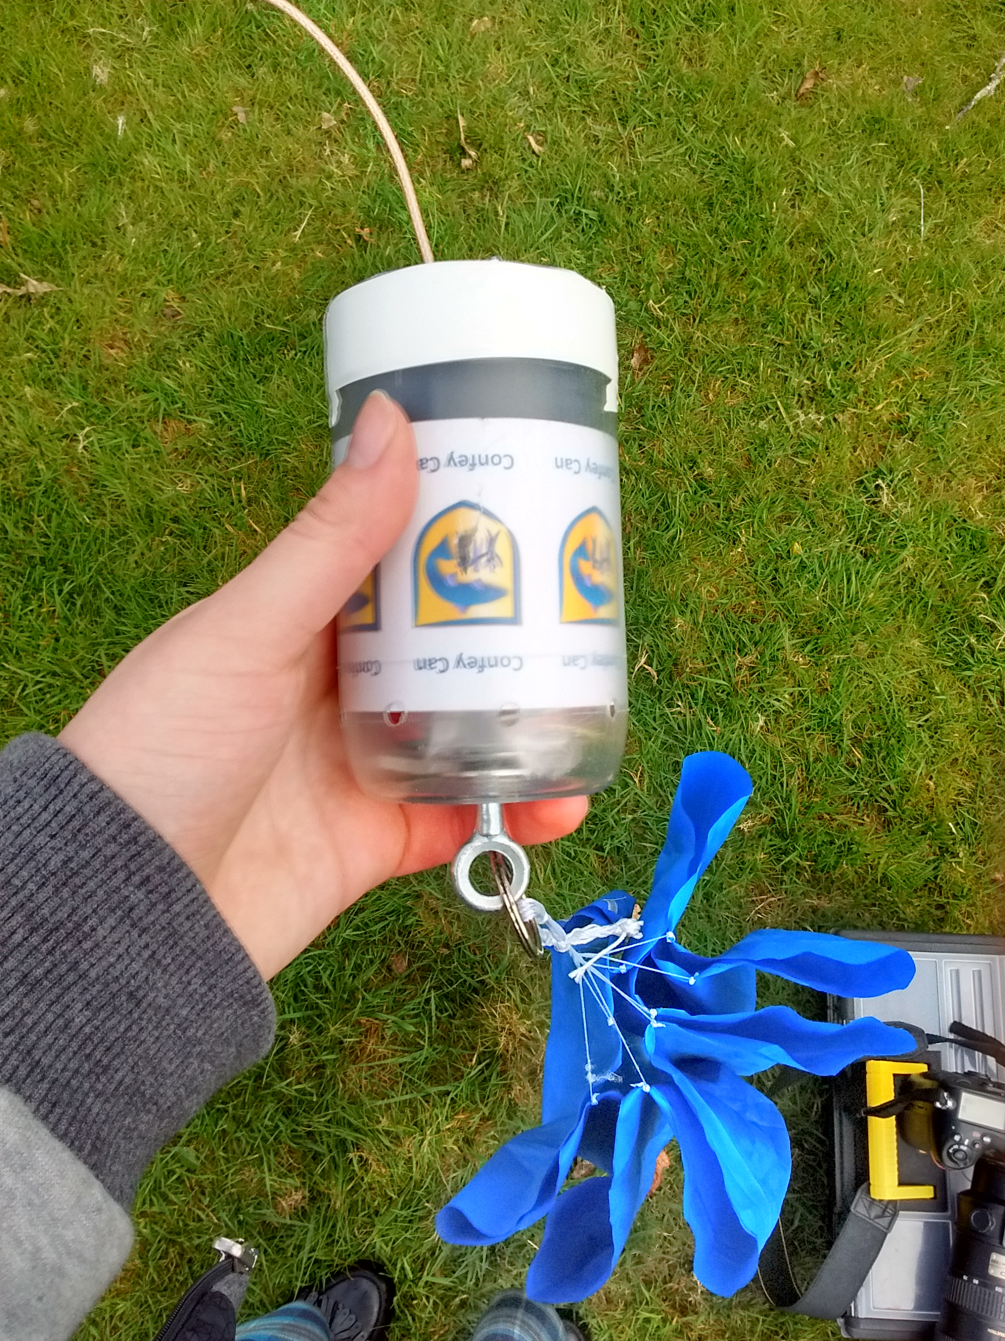
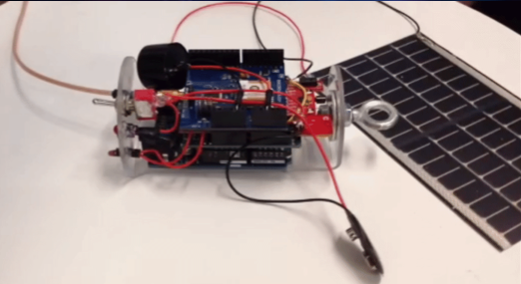
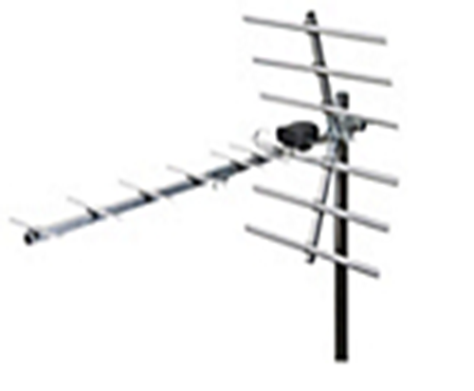
Accelerometer
Humidity Sensor
Pressure Sensor
GPS locator
Internal/External Temperature Sensor
Solar energy sensing
Light
Parachute
Buzzer
Two way Communication

Slide 6
F
For
I
Inspiration and
R
Recognition of
S
Science
T
Technology

Slide 7
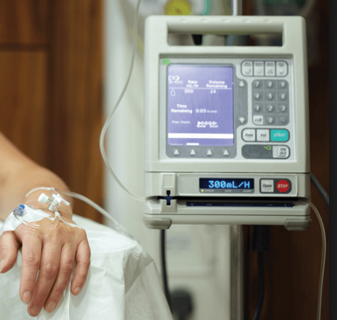
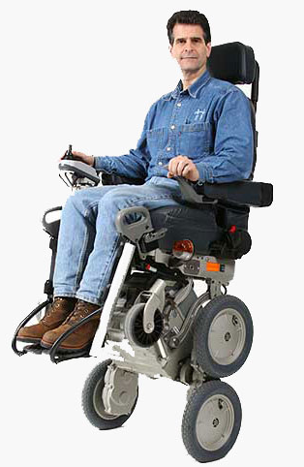
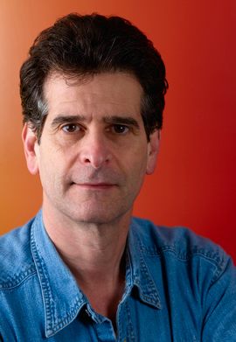
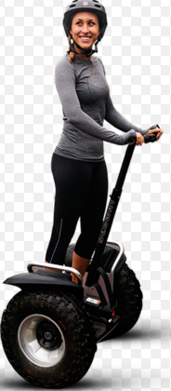
Dean Kamen
Inventor
Philanthropist
STEM

Slide 8
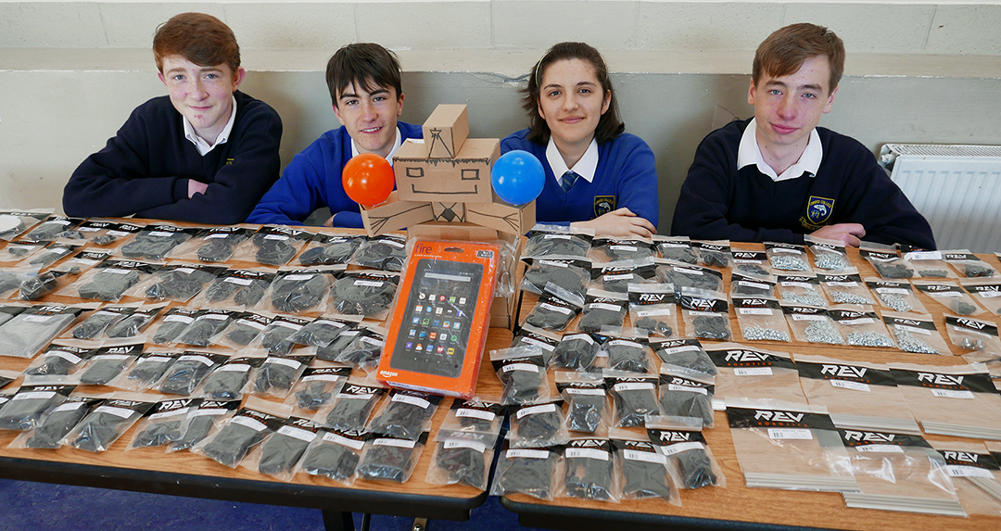
The unboxed KIT (1852 components!):

Slide 9
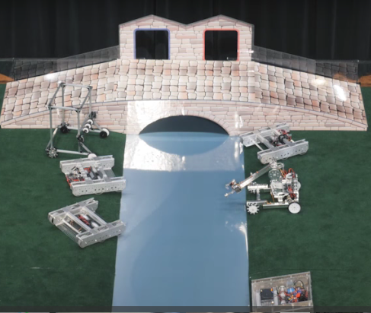
Our First Thoughts:
Adaptable
Flexible
Communication VIP

Slide 10
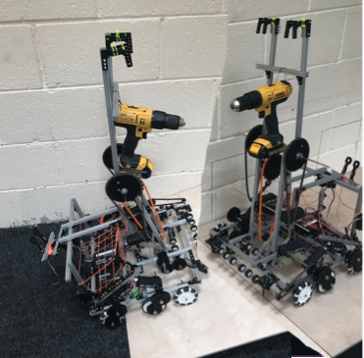
Our First Thoughts:

Slide 11
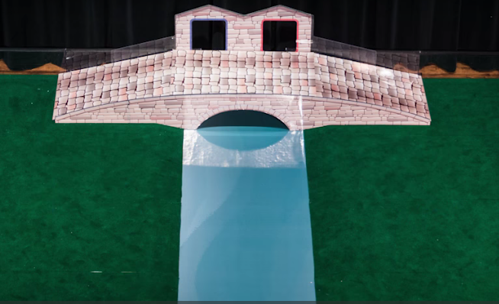
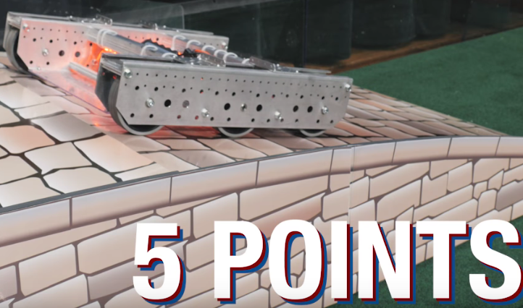
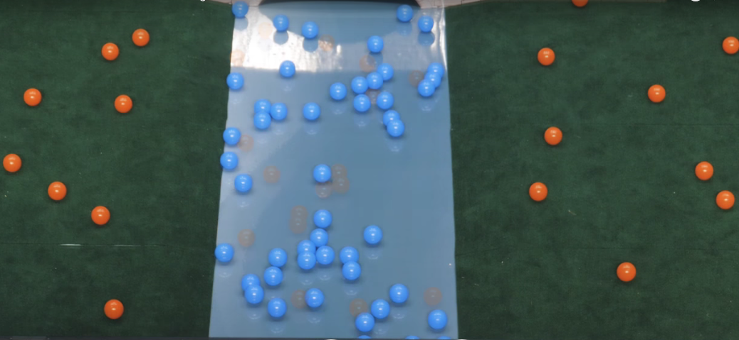
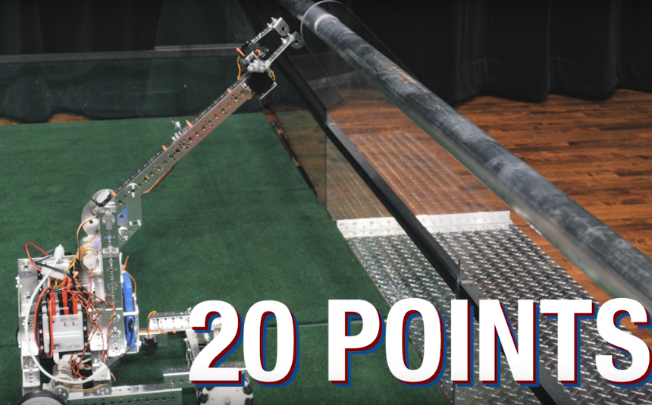
Recap:
150 secs -
4 points
200 BALLS
NEUTRAL
40B, 10O
Exclusion
Exclusion
x
15 Points!
1 point

Slide 12
BASIC ROBOT FUNCTIONS
COLLECT
STORE
RELEASE
LIFT

Slide 13
ROBOT DESIGN:
MECHANICS
FILTRATION
CODING

Slide 14
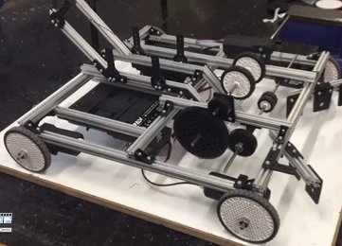
MECHANICS: Chassis/Drive

Slide 15
The BASE part 1 video

Slide 16
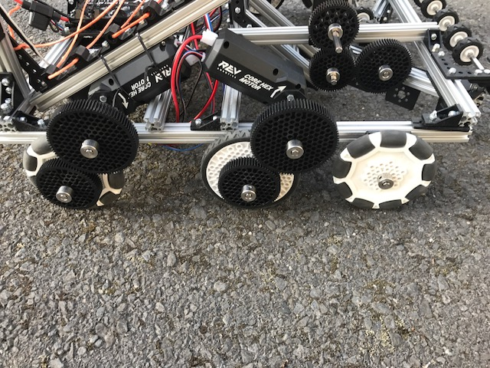
Chassis/Drive - Gears/Omniwheels
Gears for speed

Slide 17
Chassis/Drive - Gears/Omniwheels
For Friction
Omniwheels on FRONT and BACK (rotate)

Slide 18
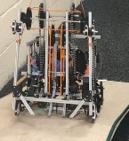
Chassis/Drive - Gears/Omniwheels
Front wheels off ground

Slide 19
Chassis/Drive - Gears/Omniwheels
Motors on middle and rear wheels

Slide 20
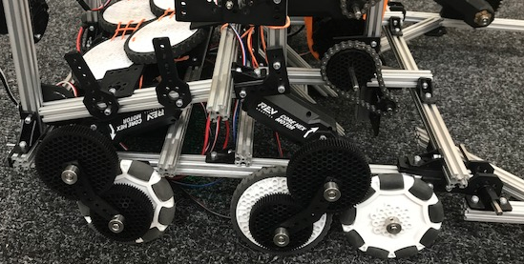
Chassis/Drive – Gear Braces
Brackets as Braces

Slide 21
Chassis/Drive - Video

Slide 22
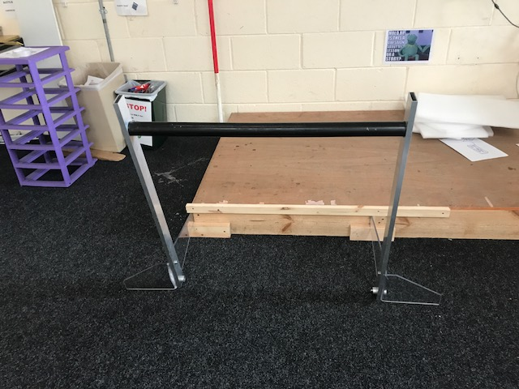
MECHANICS: The CLAW:

Slide 23
The CLAW part 1: Video

Slide 24
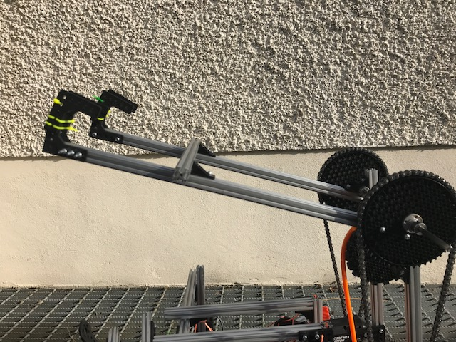
The CLAW – Angle Brackets
2 Point Contact -better STABILITY
Brackets – better GRIP

Slide 25
The CLAW Video:

Slide 26
The BEST CLAW :

Slide 27
The Final CLAW : Video

Slide 28
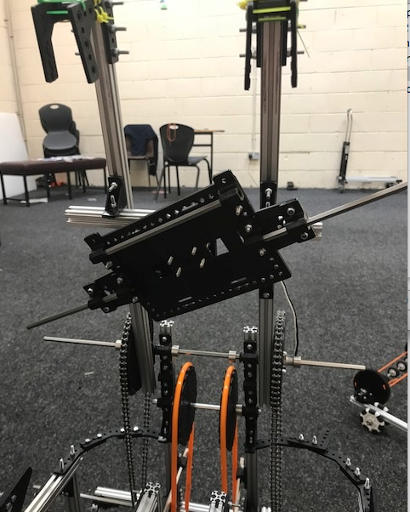
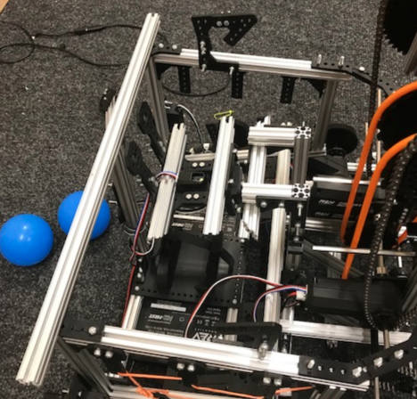
Claw Latch:
Latch holders
Latch

Slide 29
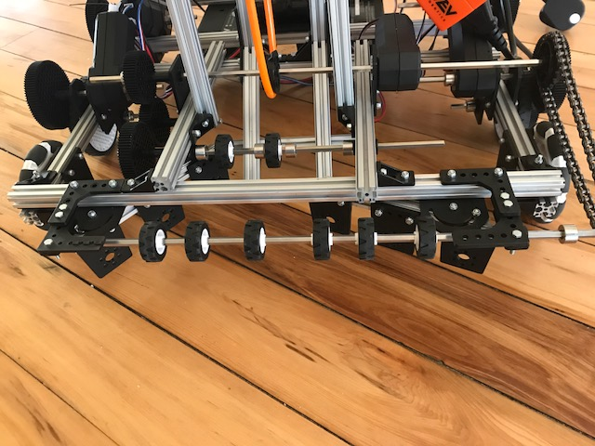
FILTRATION: Ball INTAKE:
Two wheel sets VIDEO
Extra wheel set

Slide 30
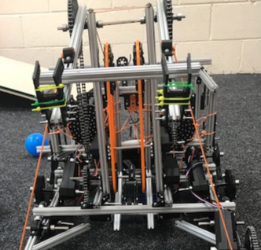
Ball Intake: Elevator:

Slide 31
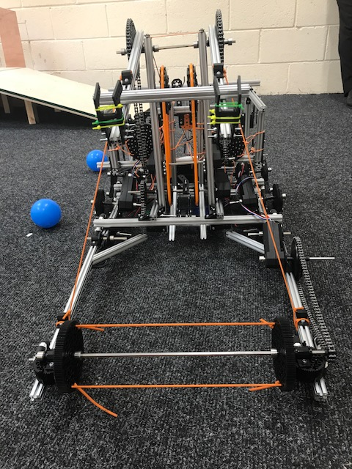
Ball INTAKE: Harvest

Slide 32
Harvesting Mechanism Video:

Slide 33
Colour Separation : Video

Slide 34
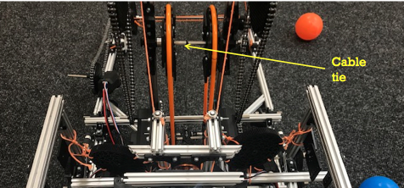
Colour separation:
Cable tie

Slide 35
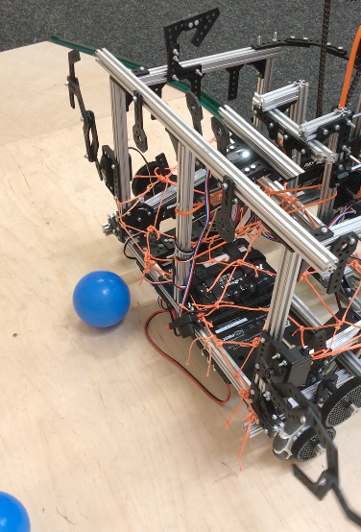
Ball Storage/Release

Slide 36
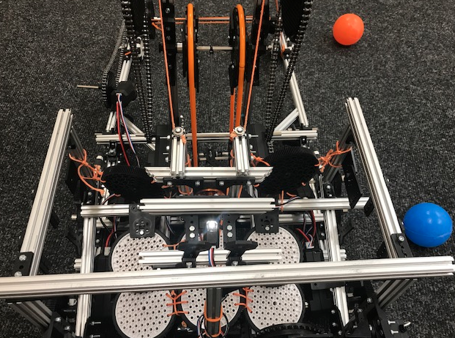
Ball Storage/Release:
Brackets
Brackets

Slide 37
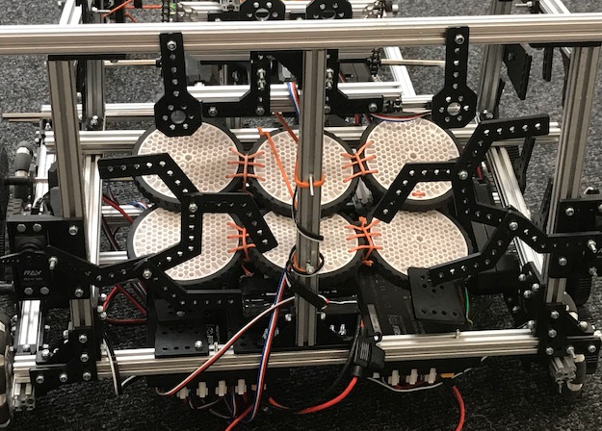
Latches: Swing Left/Right

Slide 38
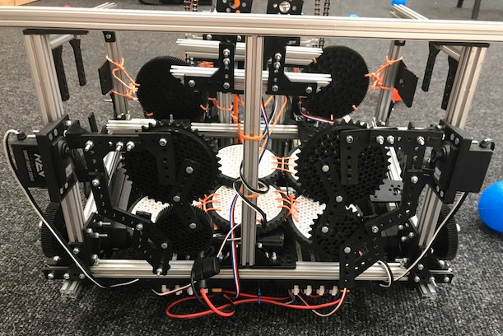
Latches: Swing in/out

Slide 39
Ball Release Video:

Slide 40
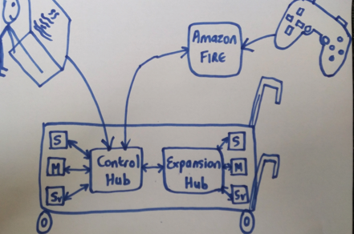
SOFTWARE – HARDWARE Communication

Slide 41
CODING:

Slide 42
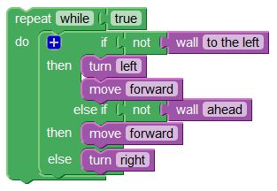
Blockly
Simplified Java.
Drag and Drop like Scratch
Easy to understand/program

Slide 43
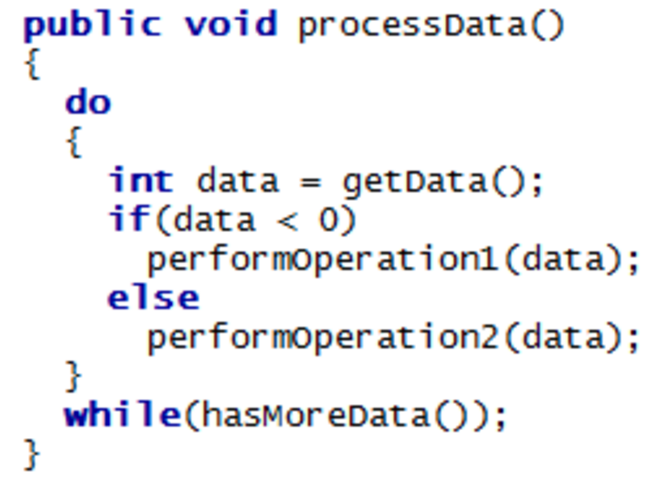
Java
FASTER communication with tablet
Better FLEXIBILITY for coding
EASIER to use ultimately
More MATHEMATICAL functions

Slide 44
Software development to date:
Enabled WIRELESS programming
BASIC MOTION
RAISE/LOWER Claw/Harvester
COLOUR separation or NO separation
Keep SCORE
Ball RELEASE 1or 2 latches
Turn ON/OFF Wheel Intake
Turn ON/OFF Harvester Intake

Slide 45
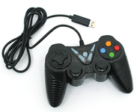
Customised GAMEPAD:

Slide 46
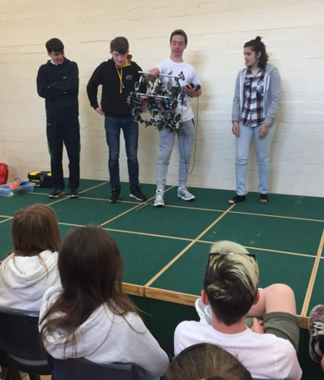
OUTREACH: Primary School Visits
5th and 6th Class students (12 – 13 yrs)
Explain Competition
Underlying purpose
How Robot works
Demo
Students have a go

Slide 47
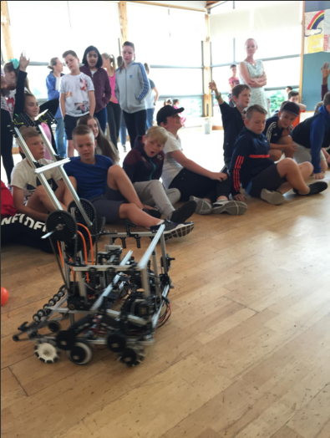
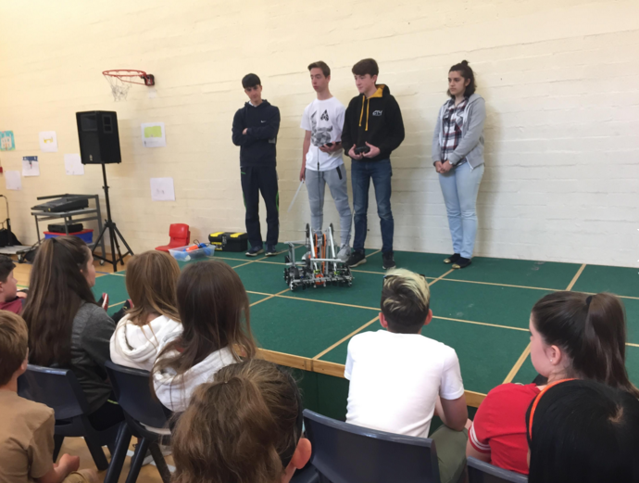
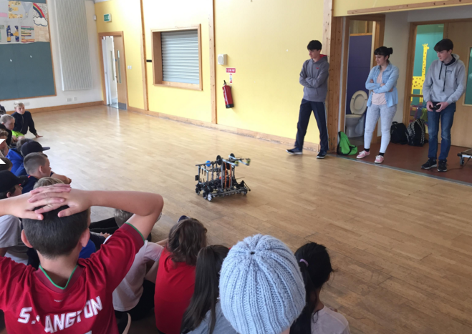
OUTREACH: Primary School Visits

Slide 48
OUTREACH:
Liffey Champion
CoderDojo Coolest Projects, RDS
TV3
Intel
KWETB

Slide 49
The LAST few Days:
PRACTICE!!!
Timing
Identify necessary design tweaks
STRATEGIES
Think
Communicate

Slide 50
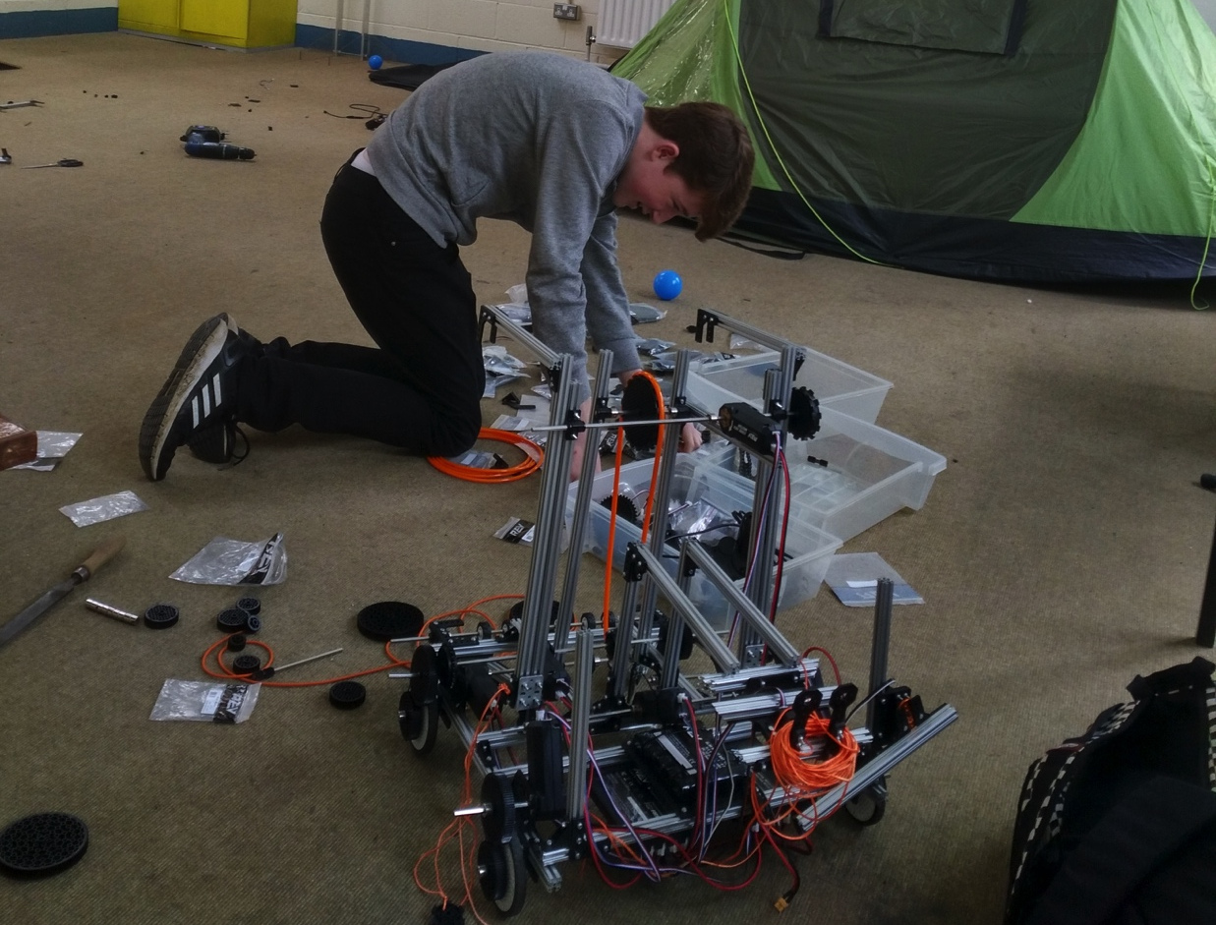
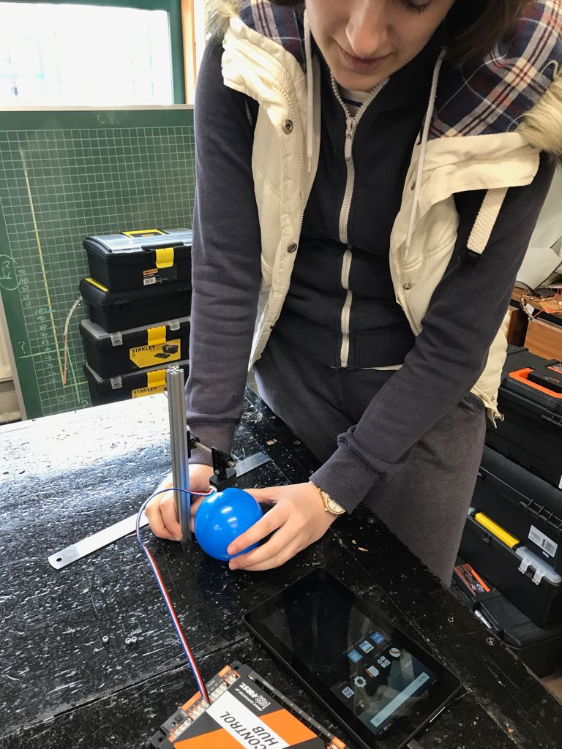
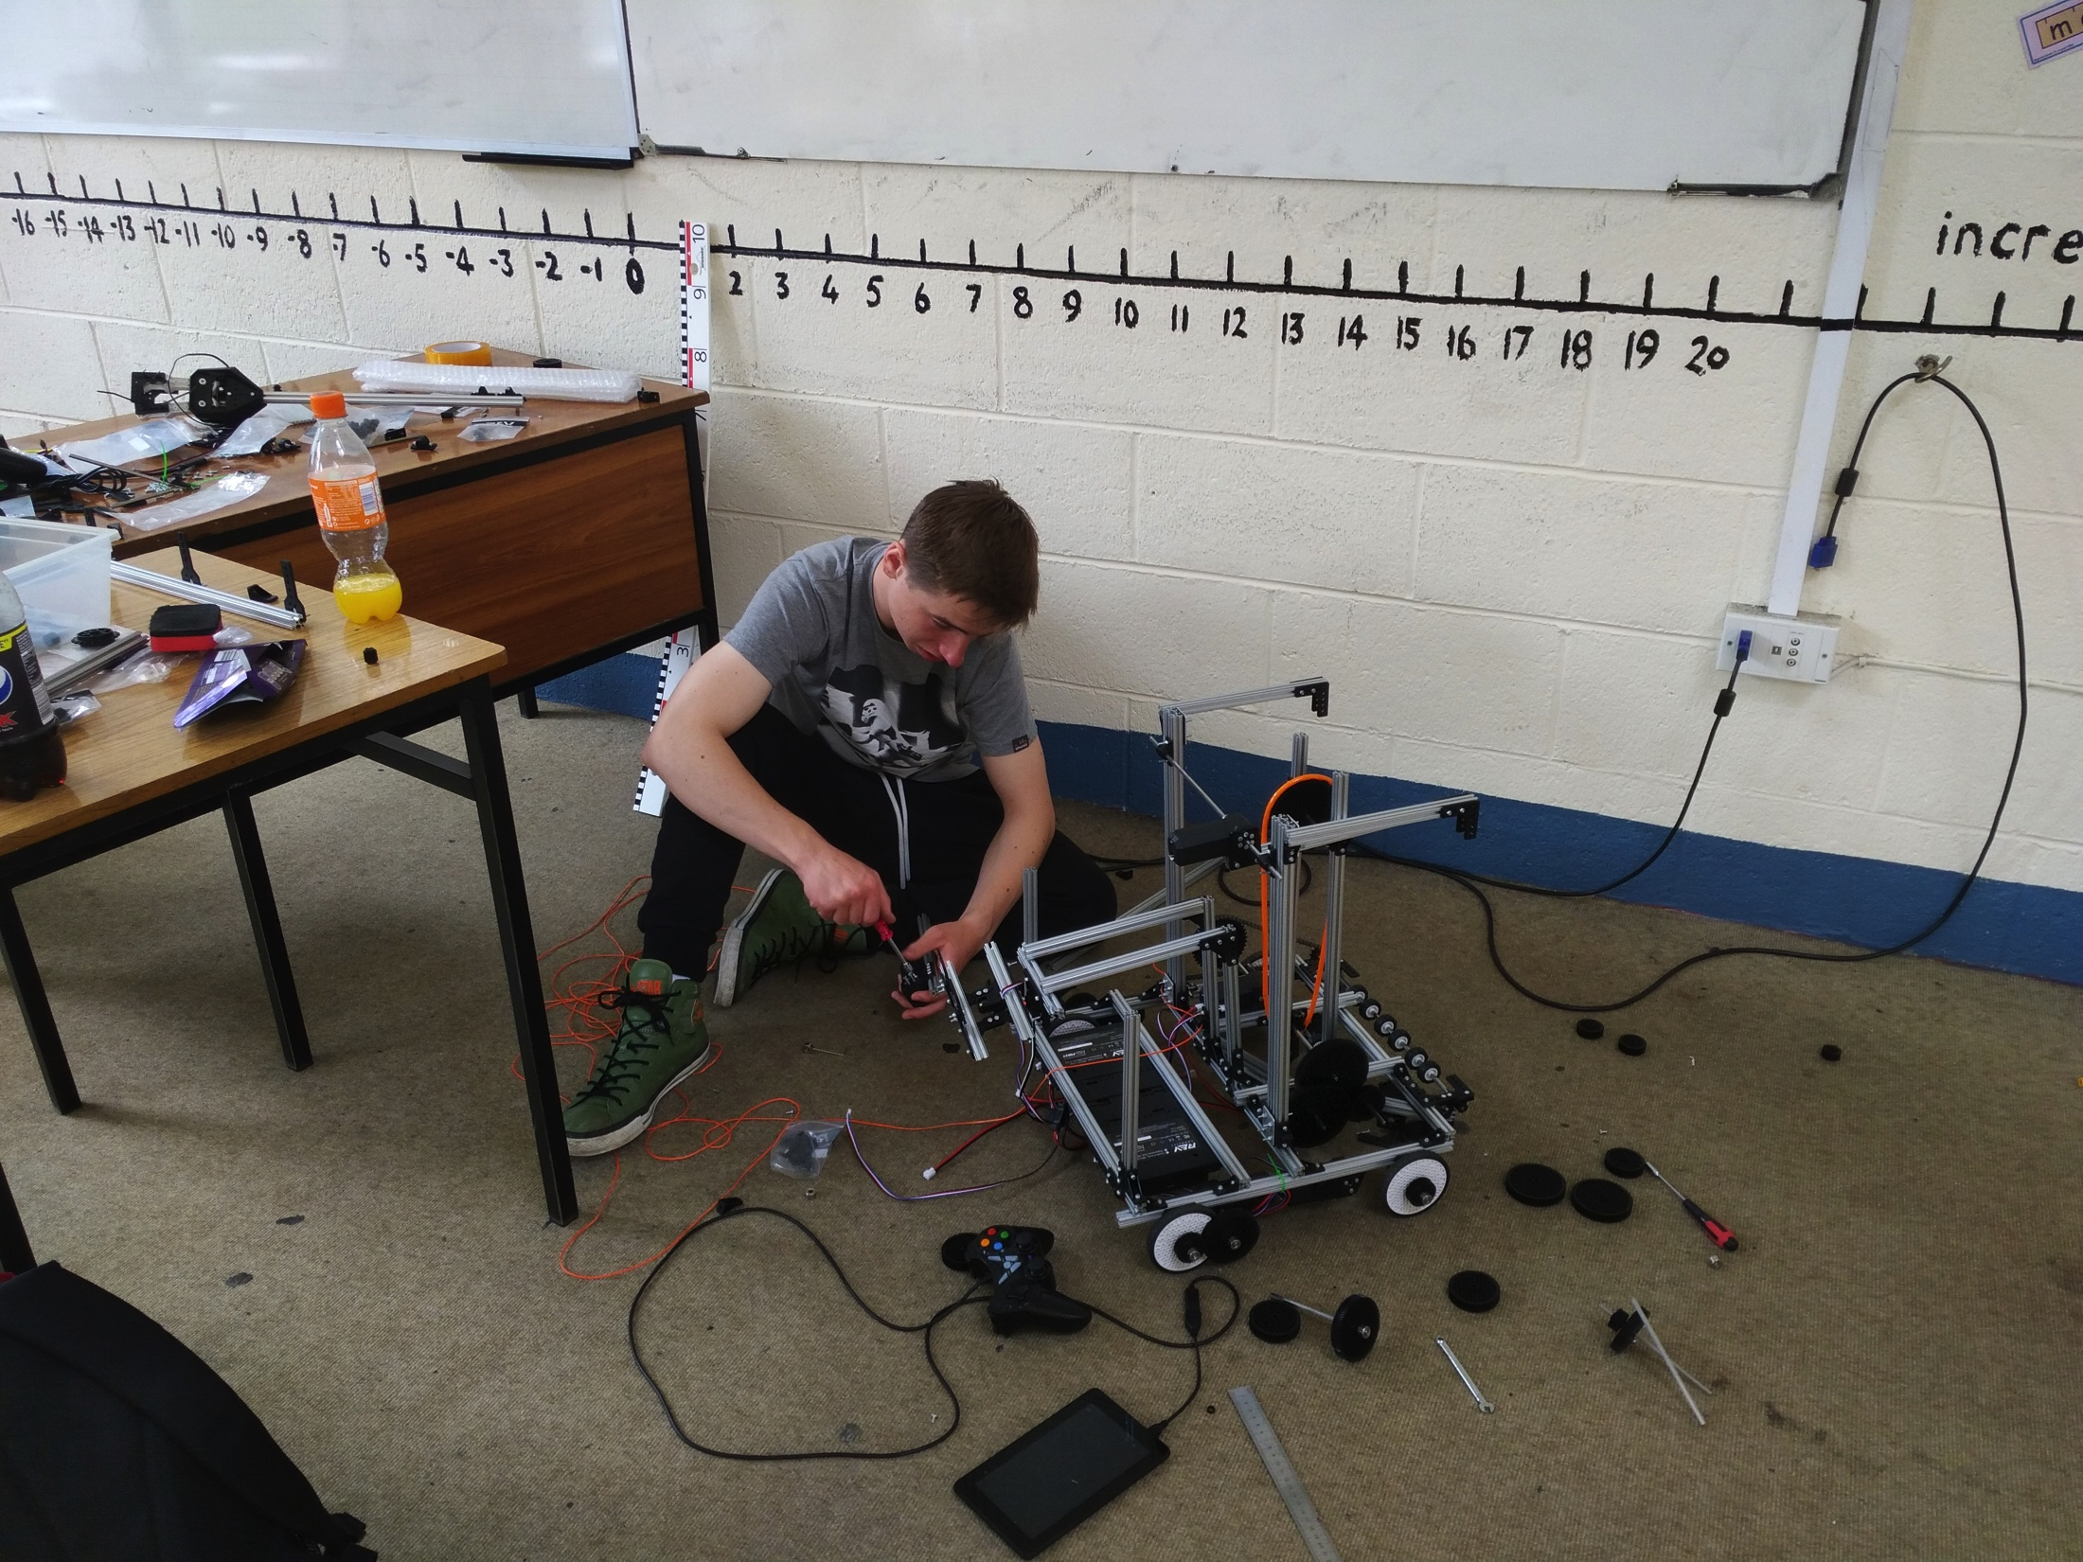
Hard Work ......But...!

Slide 51
We’ve Learnt a lot !
Team work
Planning
Agreeing roles by identifying strengths
Teamwork with the other participating teams
Other
Learning through doing – trial and error
Learn from others experiences
Learn through discussion as a team
Be flexible – willing to adapt/improve on weaknesses
Refuse to give up

Slide 52
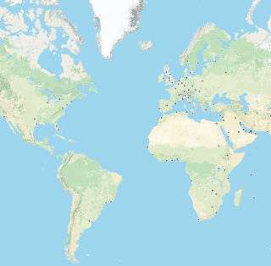
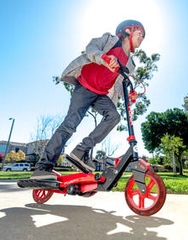
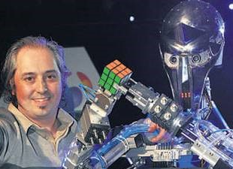
THANK YOU
Confey Community College

Slide 54
FIRST GLOBAL World Robotics Competition
Team IRELAND

