Slide 1
Confey can
By Confey College

Slide 2
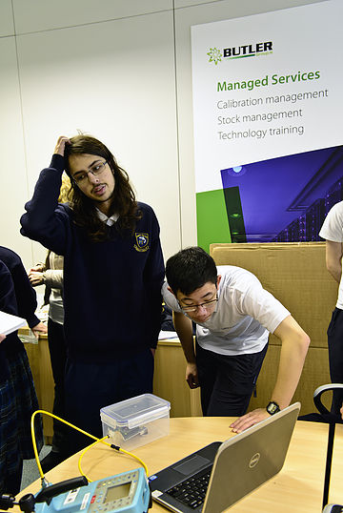
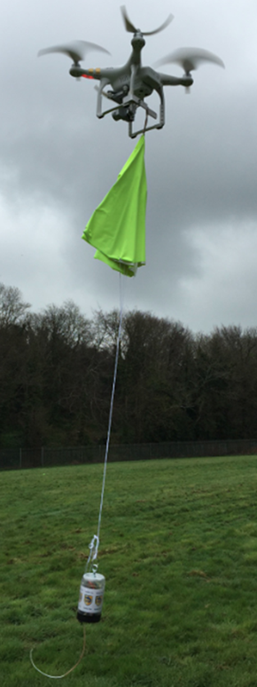
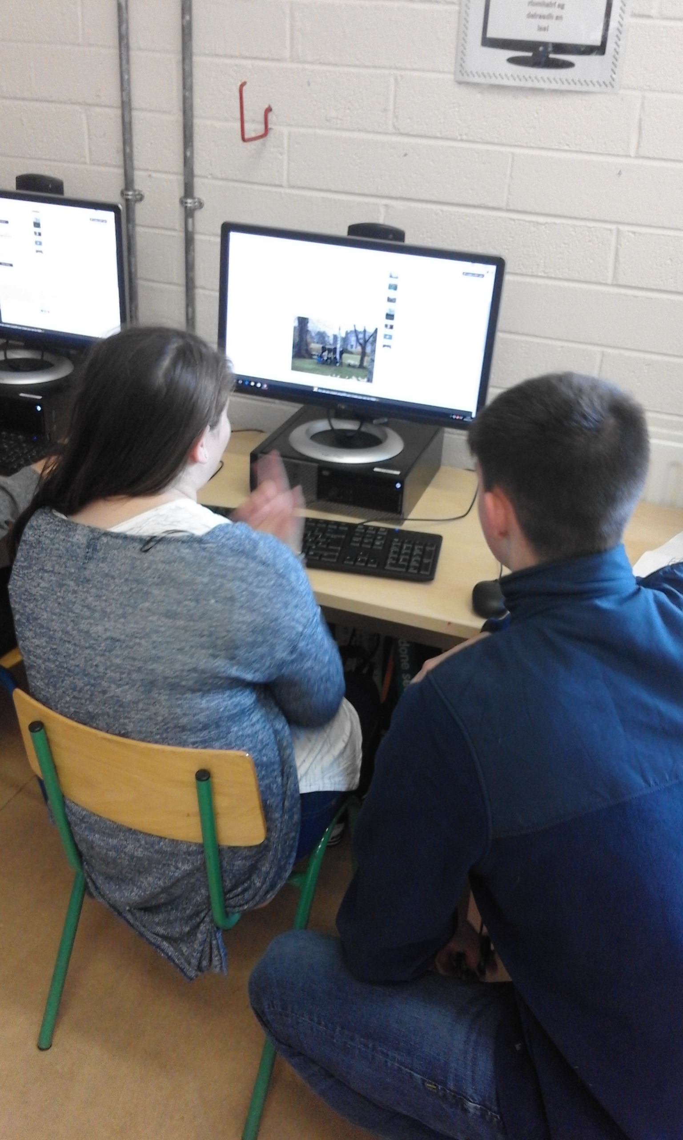
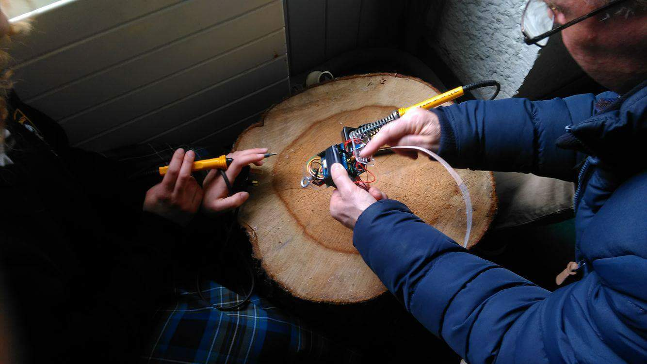
Presentation overview
Missions & Progress
Parachute Design
Can Design
Calibration
Outreach

Slide 3
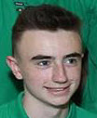
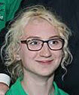
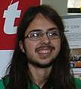
The TEAM
Liam Murphy
Outreach
Julia Waszkiewicz
Parachute
Gergely Gellert
Programming
Conor Walsh
Calibration
Alex Bourke
Data Analyst
Naoise Barry
Mechanic

Slide 4
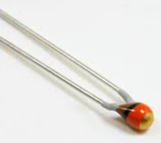
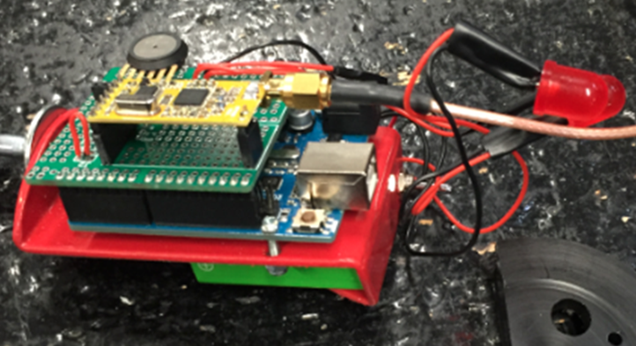
Primary mission
Air Temperature
(Outside)
Air Pressure
ARDUINO
program output
canLOG.txt
Cleandata. txt
Secondary Data.xls
PYTHON
program
Present the Data

Slide 5
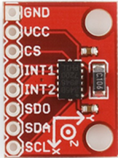
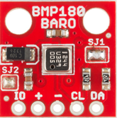
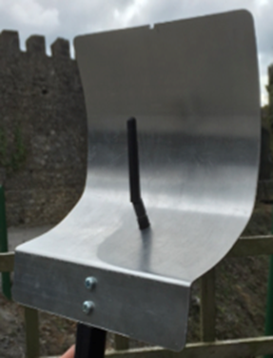
Secondary Missions
Measure Relative Humidity
Measure X,Y,Z gForces and Resultant gForce
More accurate Pressure measurement
Measure Internal temperature
GPS Location
Improve Signal Strength

Slide 6
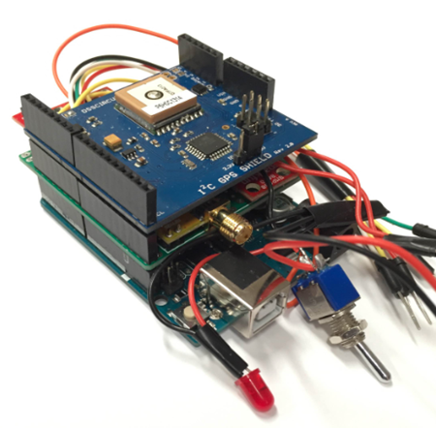
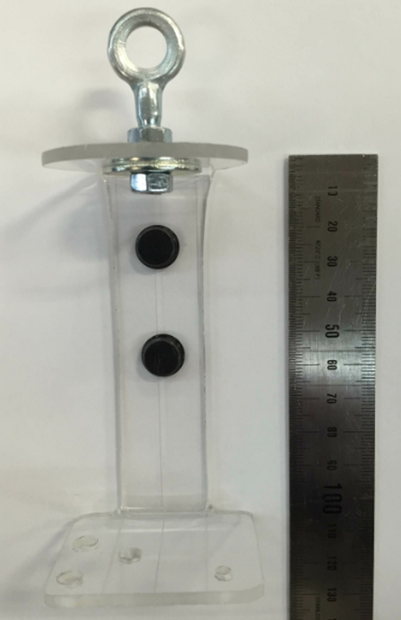
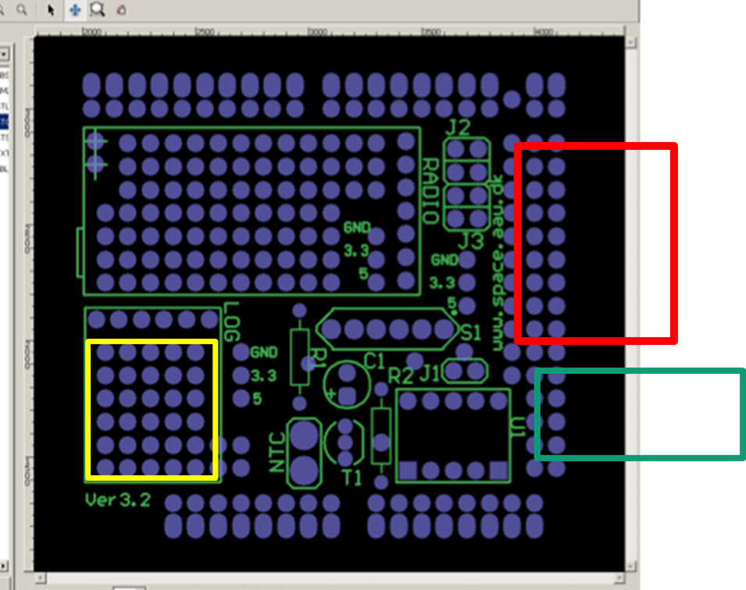
Modified shield headers so GPS shield sits on top
polycarbonate spine to reduce signal loss
modify shield to take all new sensors

Slide 7
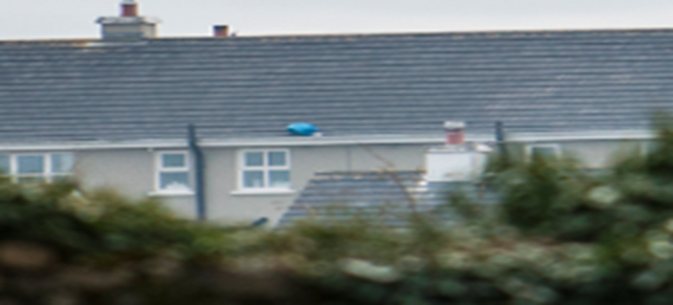
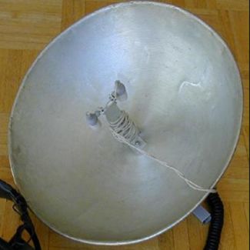
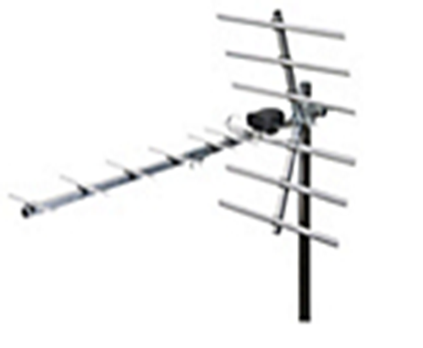
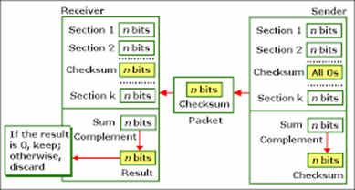
Improvements for Europe:
Increase terminal velocity
Increase parachute strength and cord attachment
Improve Signal Reception
Improve error correction

Slide 8
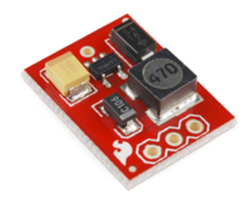
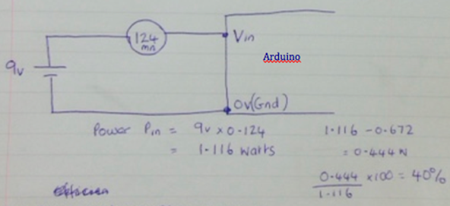
Improvements for Europe:
5V DC-DC Convertor/Regulator
Doubled Battery Lifetime
(4 -> 8 hrs)
Reduced Power Consumption
(by 40%)

Slide 9
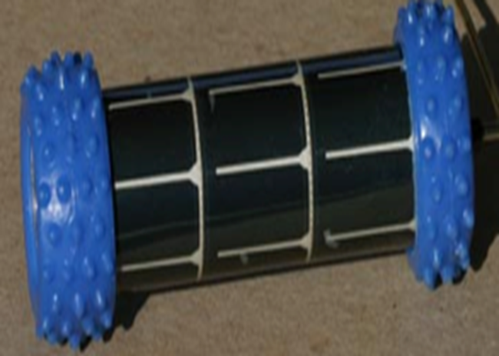
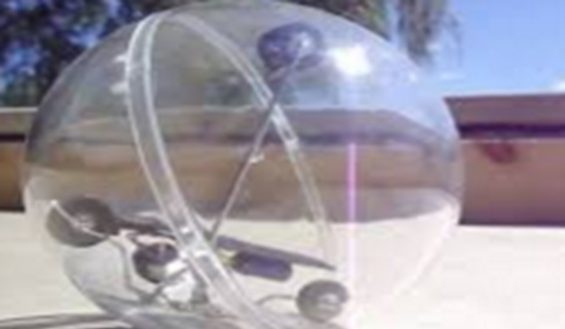
The bigger picture
CanBot!

Slide 10
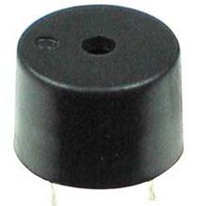
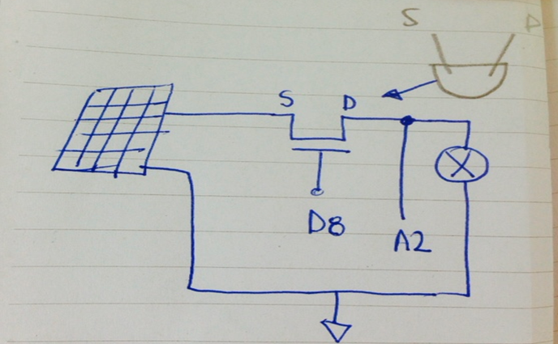
Additions for Europe
Measure Power from Sun (V$2$/Rbuzz )

Slide 11
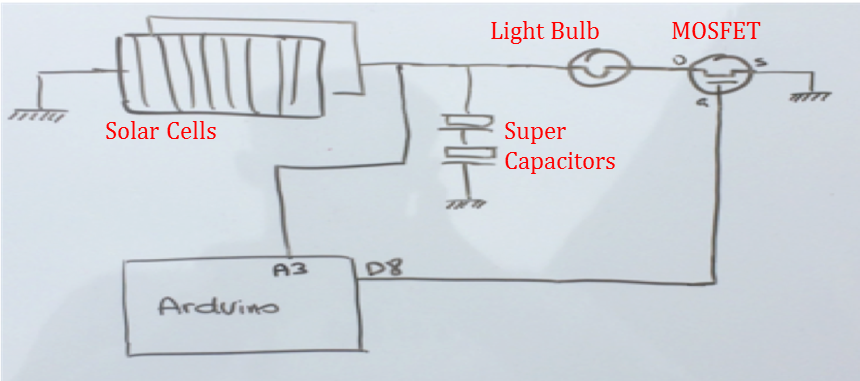
Additions for Europe

Slide 12
Two-way communication
CanSat to Broadcast messages from groundstation
Ground station to turn Buzzer On/Off
CanSat to perform mathematical operations based on input from Ground Station

Slide 13
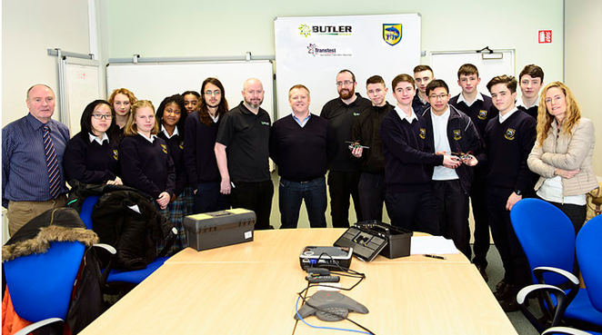
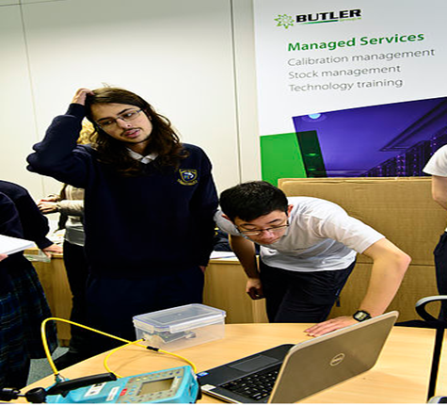
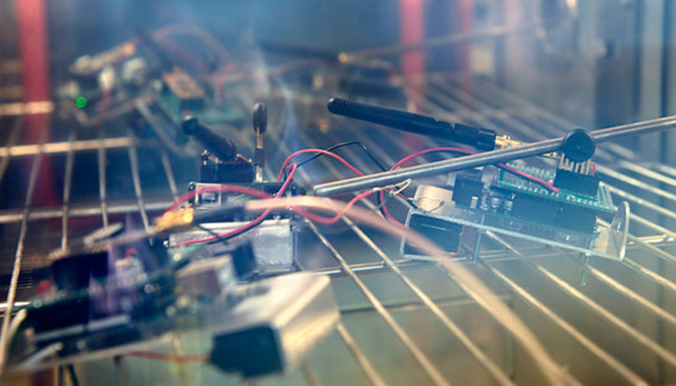
Testing & calibration

Slide 14
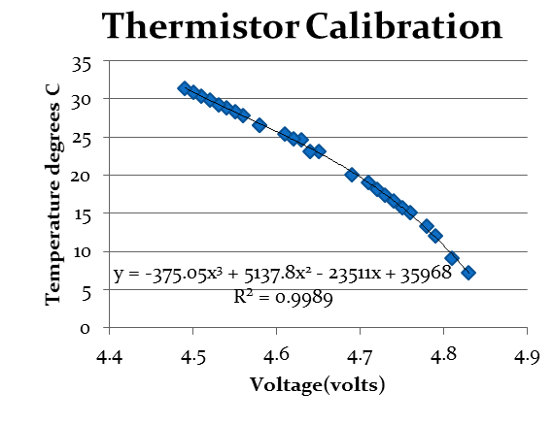
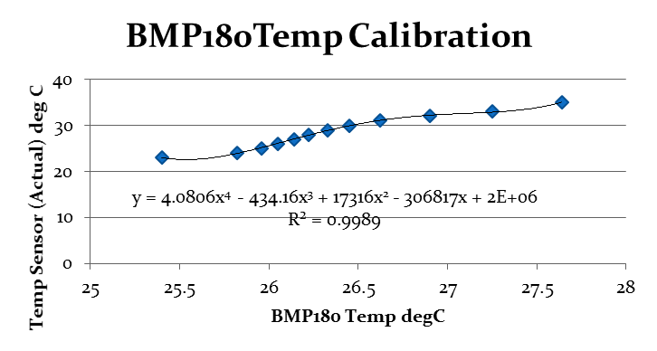
Testing & calibration continued

Slide 15
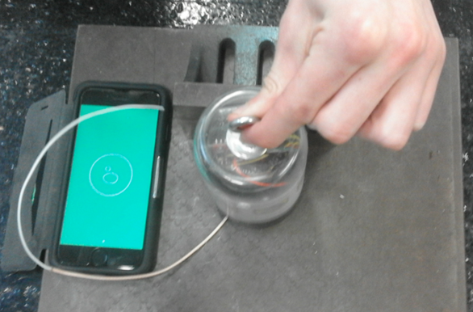
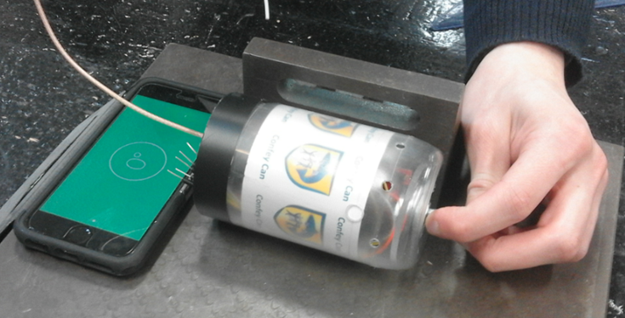
Further calibration
ADXL345 Accelerometer
* Tested All 3 axis in both directions - offset

Slide 16
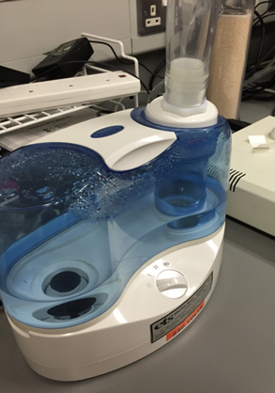
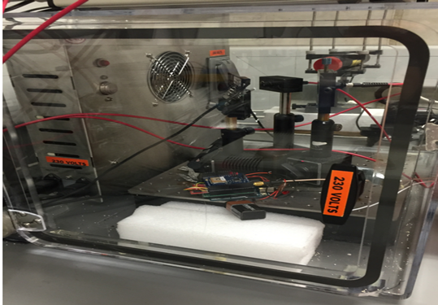
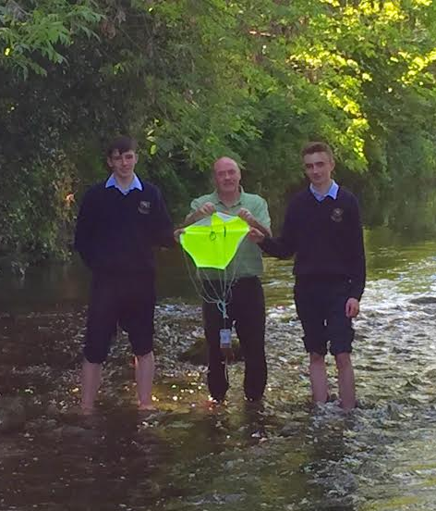
Relative Humidity (HIH4030)Calibration:

Slide 17
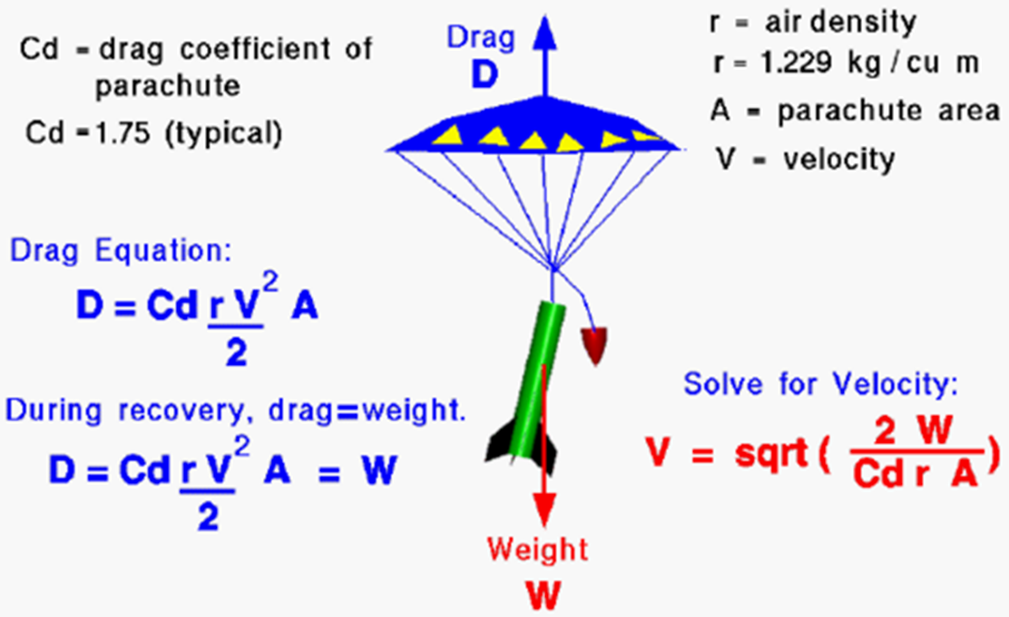
The Parachute – Terminal velocity
CanSat Breaks - 11m/s ≥Terminal velocity ≥ 8m/s - CanSat Drifts

Slide 18
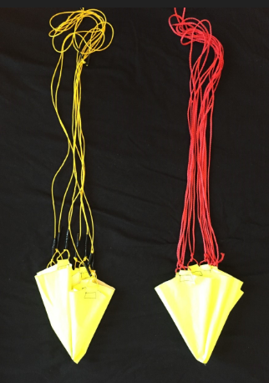
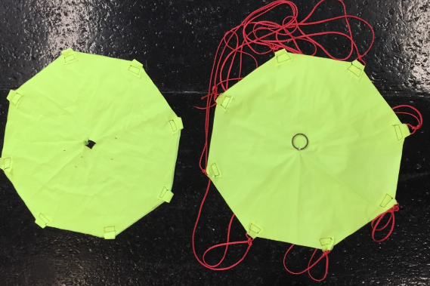
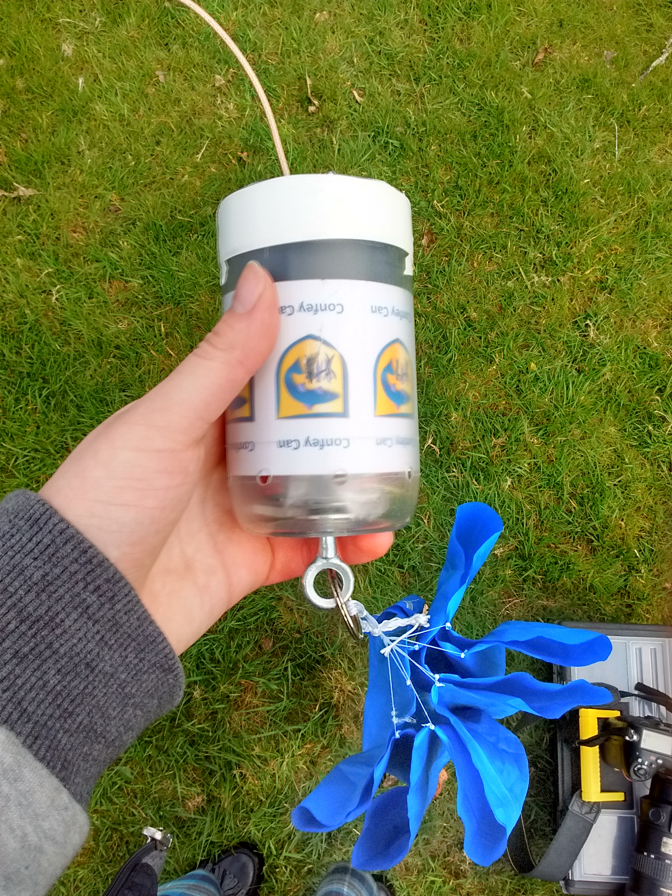
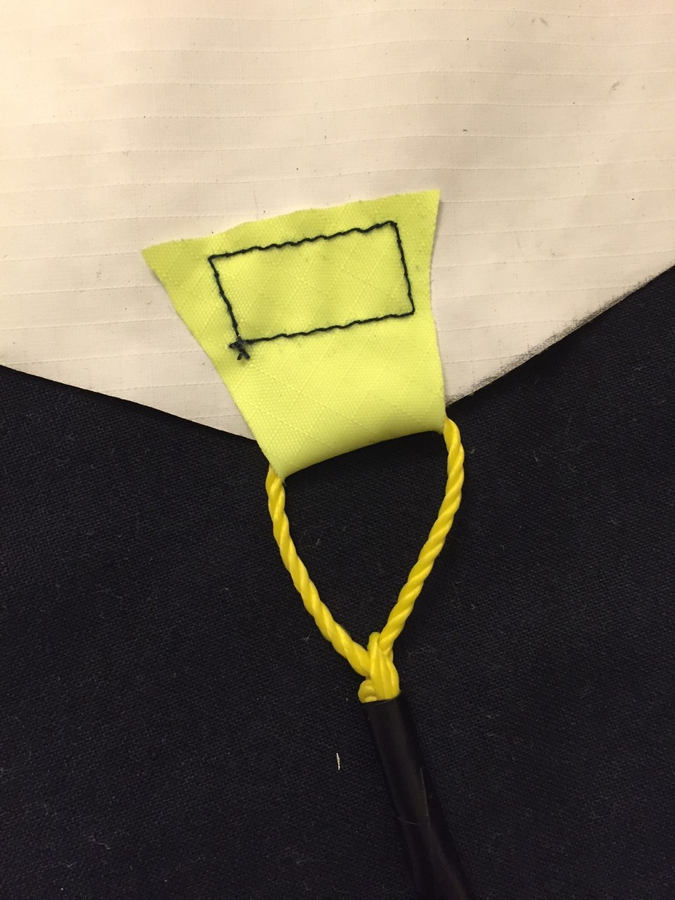
The Parachute – Stability

Slide 19
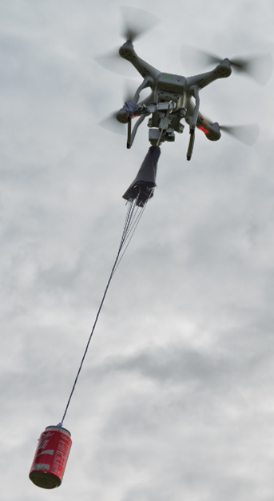
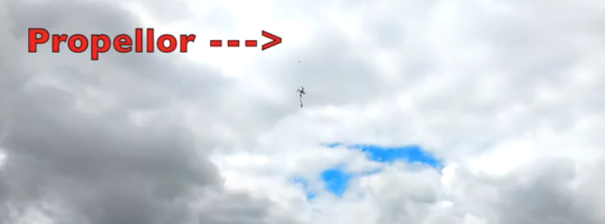
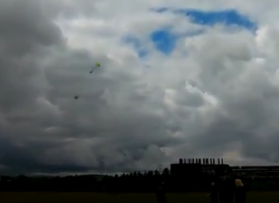
THE parachute - Testing

Slide 20
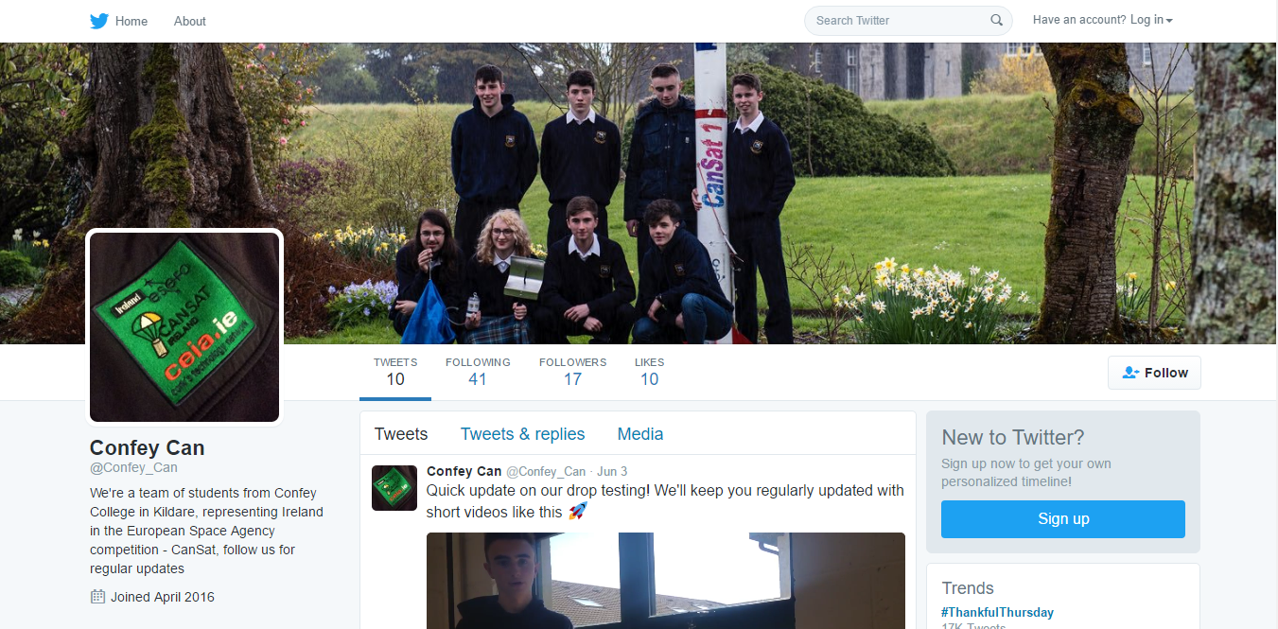
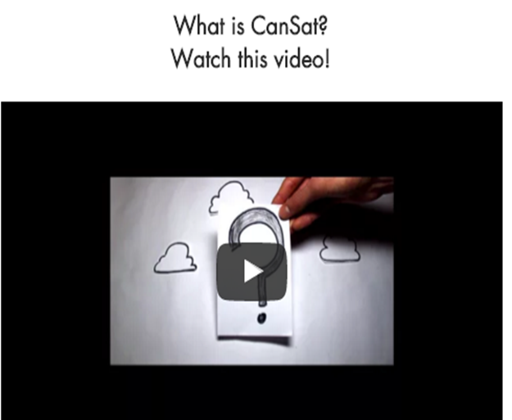
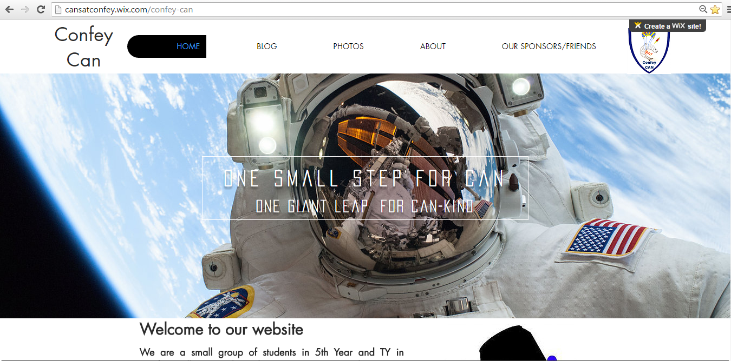
Outreach – Online presence

Slide 21
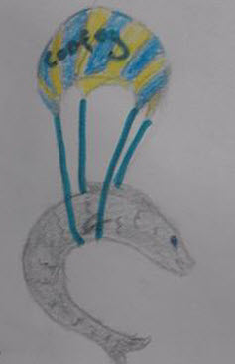
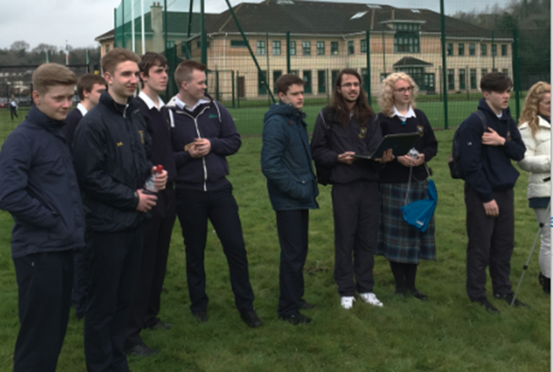
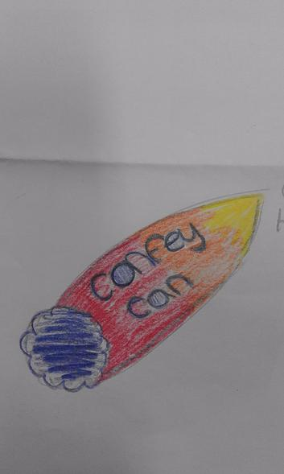
Outreach – within the school

Slide 22
Outreach – local area

Slide 23
Outreach – in the wider community

Slide 24
Outreach – sponsorship

Slide 25
Thanks for listening!!!
ConfeyCan….the FINAL FRONTIER

